Slide 1
Accenture Hirepro
Sample Questions

Slide 2
Section : 2025 Batch
Section wise Questions
English Ability - 52
Abstract Reasoning - 37
Critical Reasoning – 84
Ms Office - 29
Pseudocode - 56
Networking - 43

Slide 3
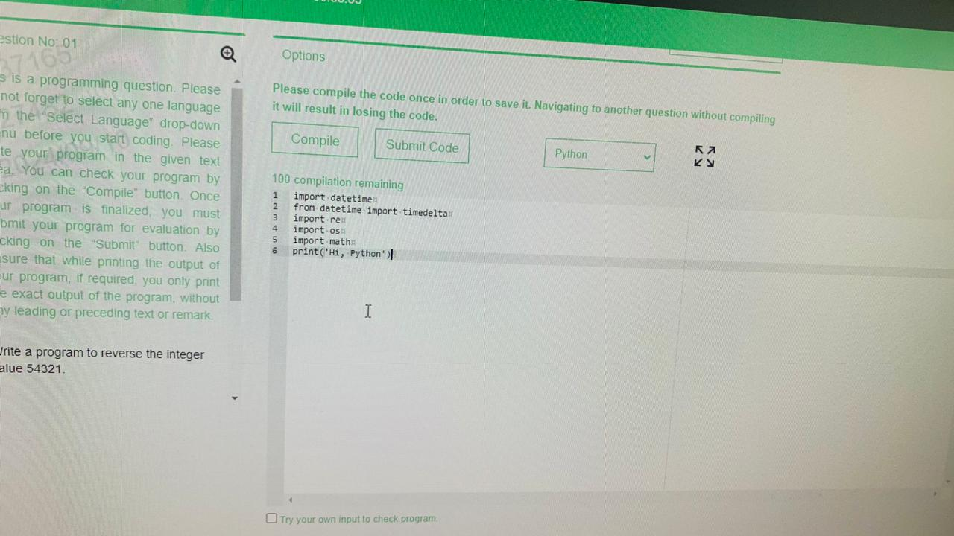

Slide 4
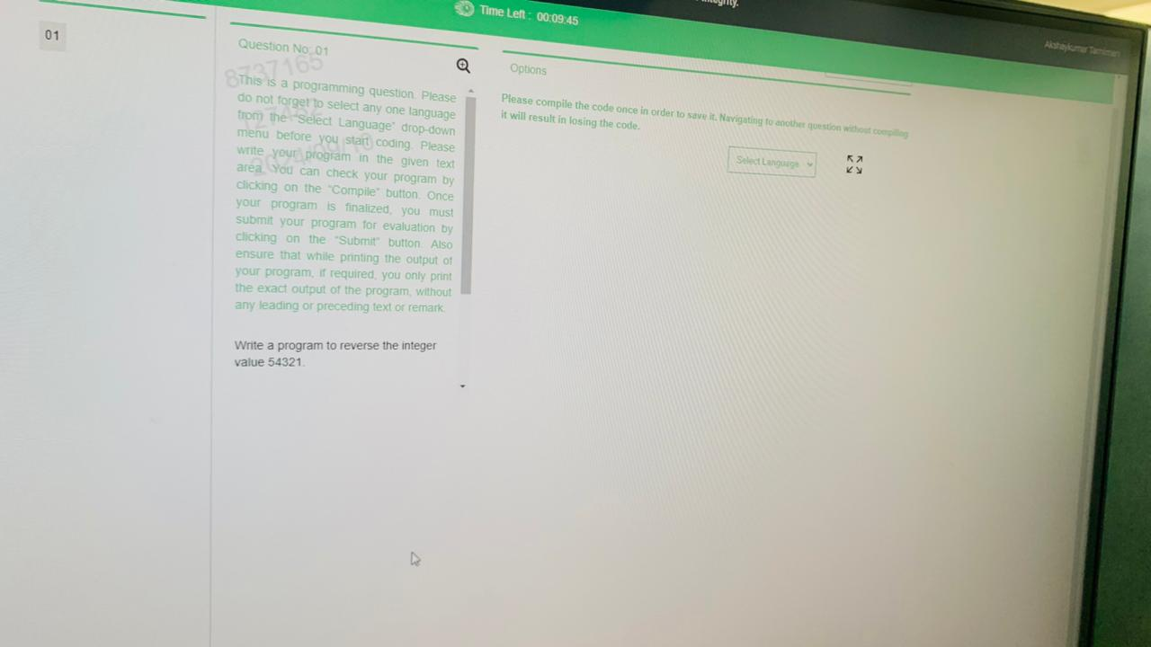

Slide 5
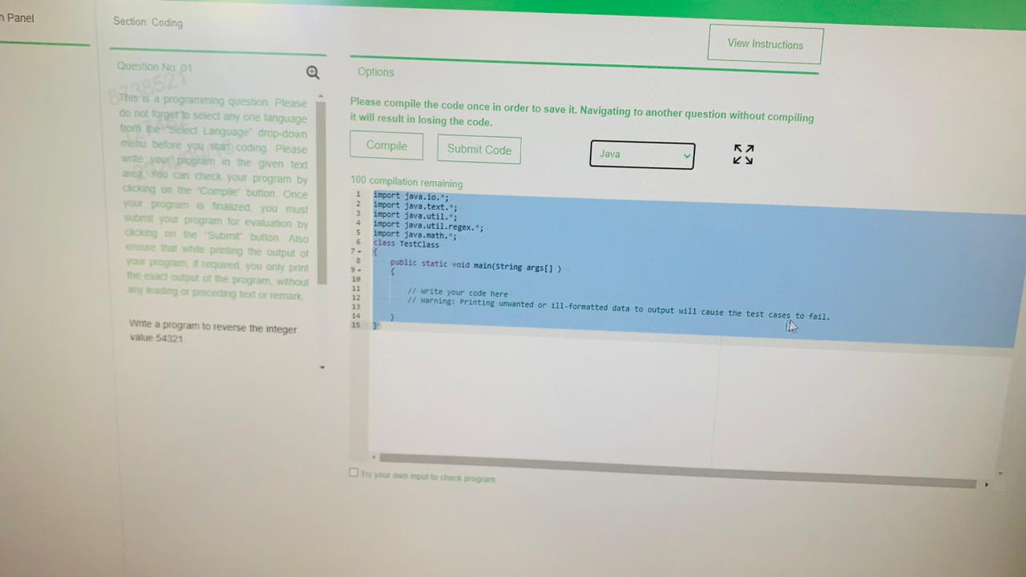

Slide 6
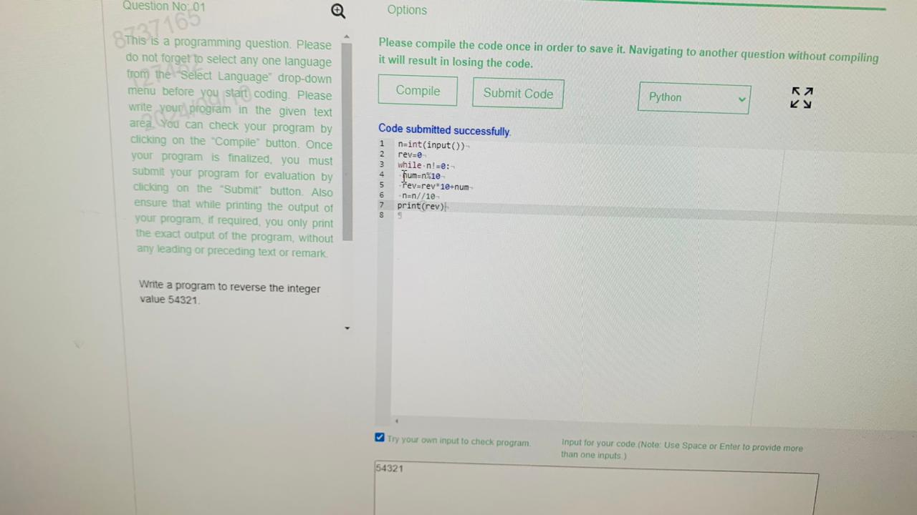

Slide 7
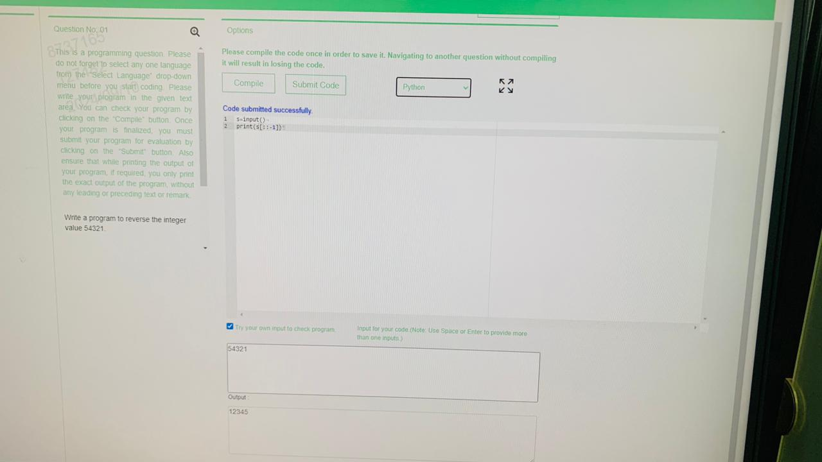

Slide 8
English Ability
Accenture Hirepro

Slide 9
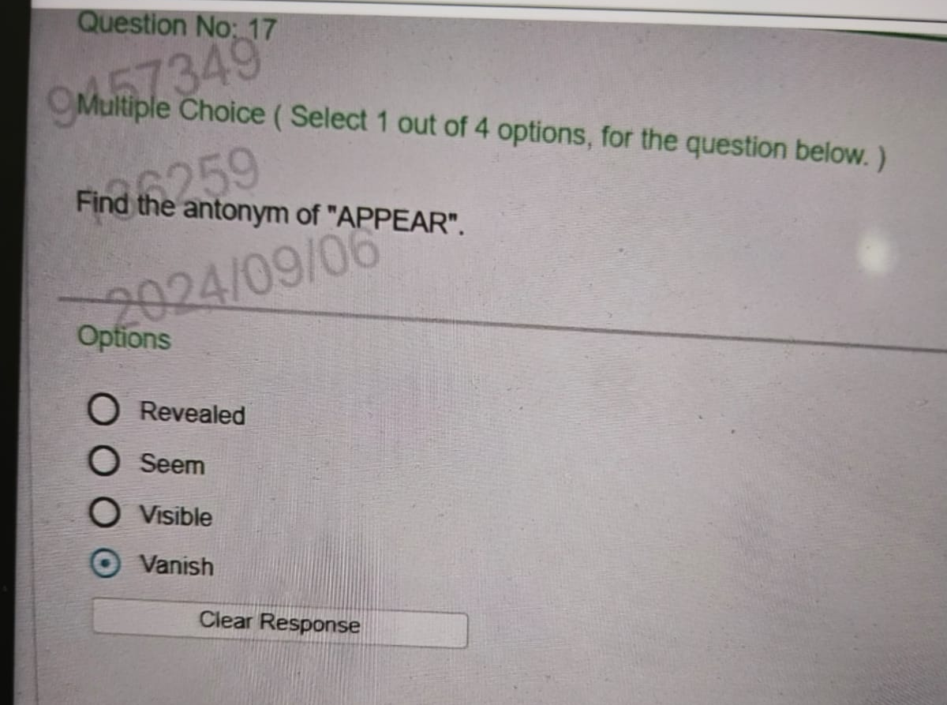

Slide 10
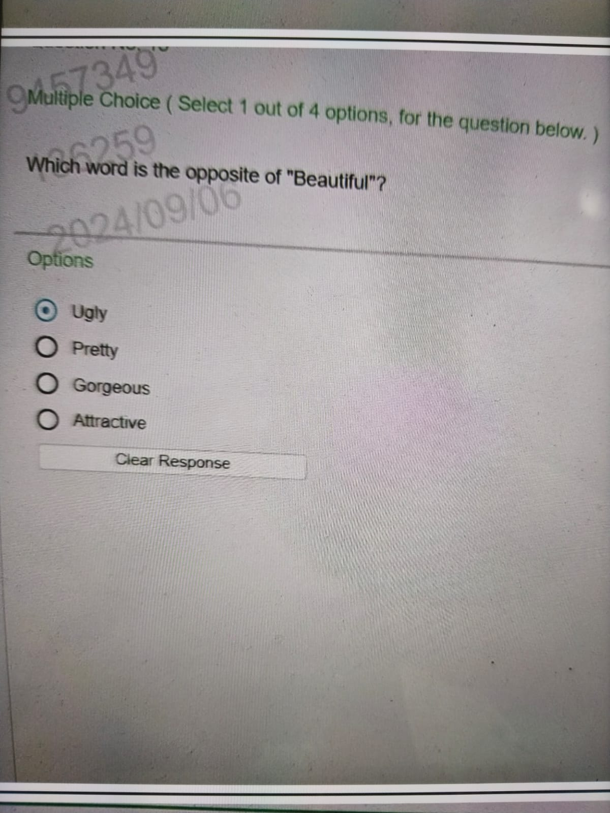

Slide 11
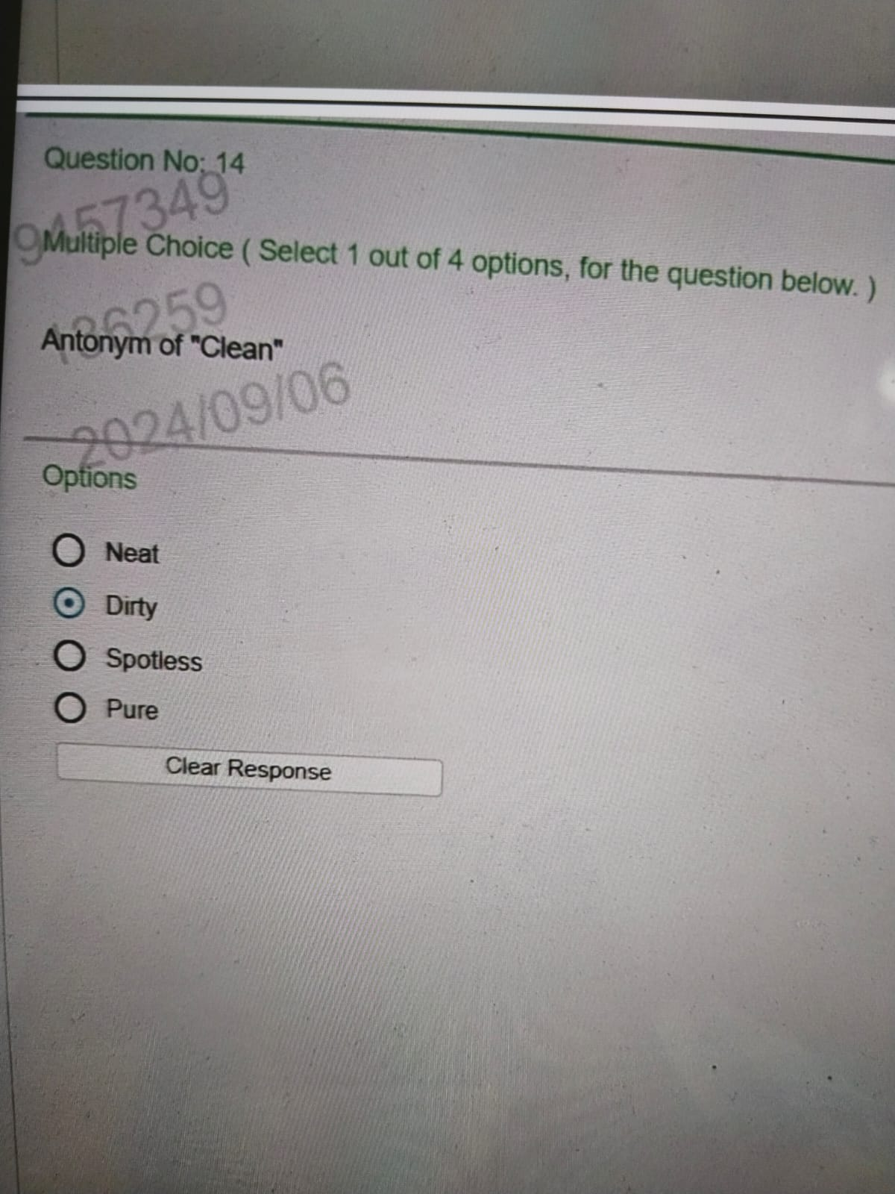

Slide 12
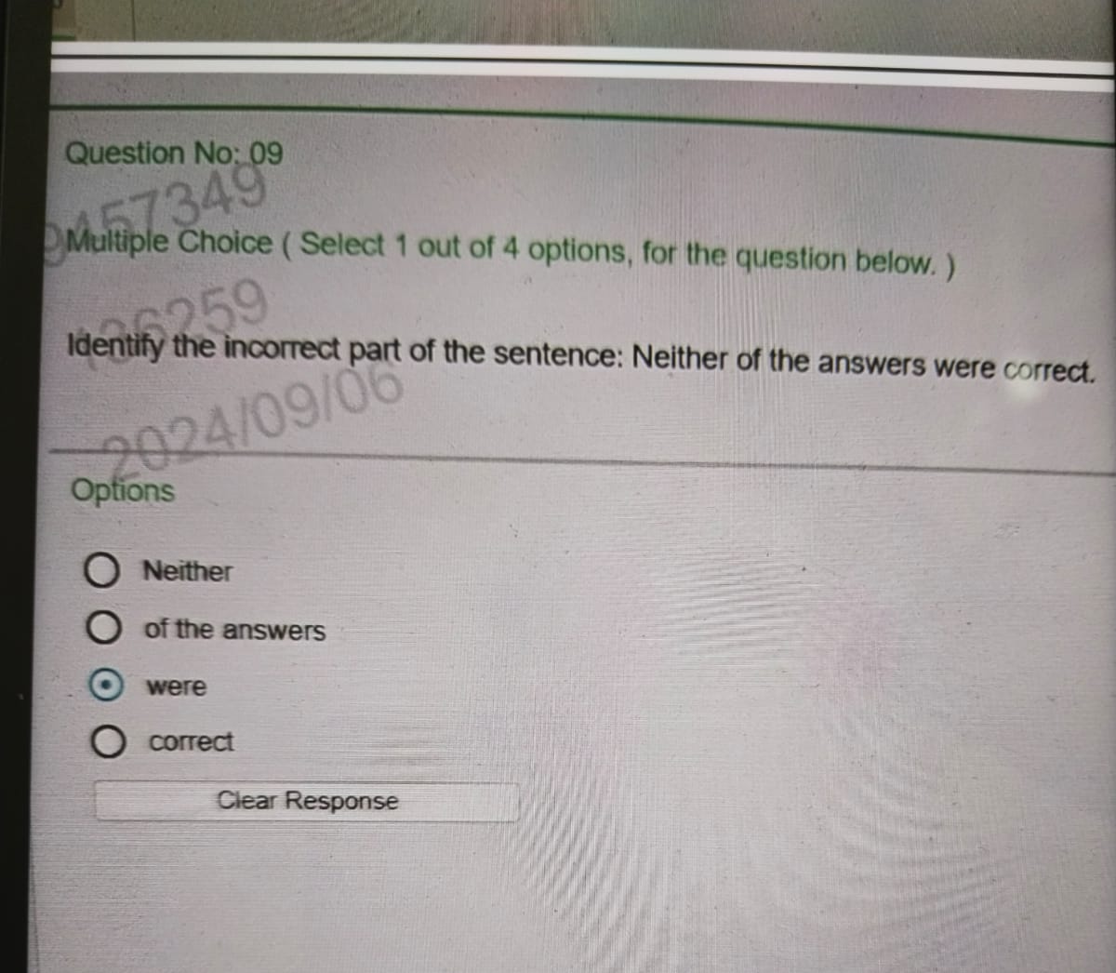

Slide 13
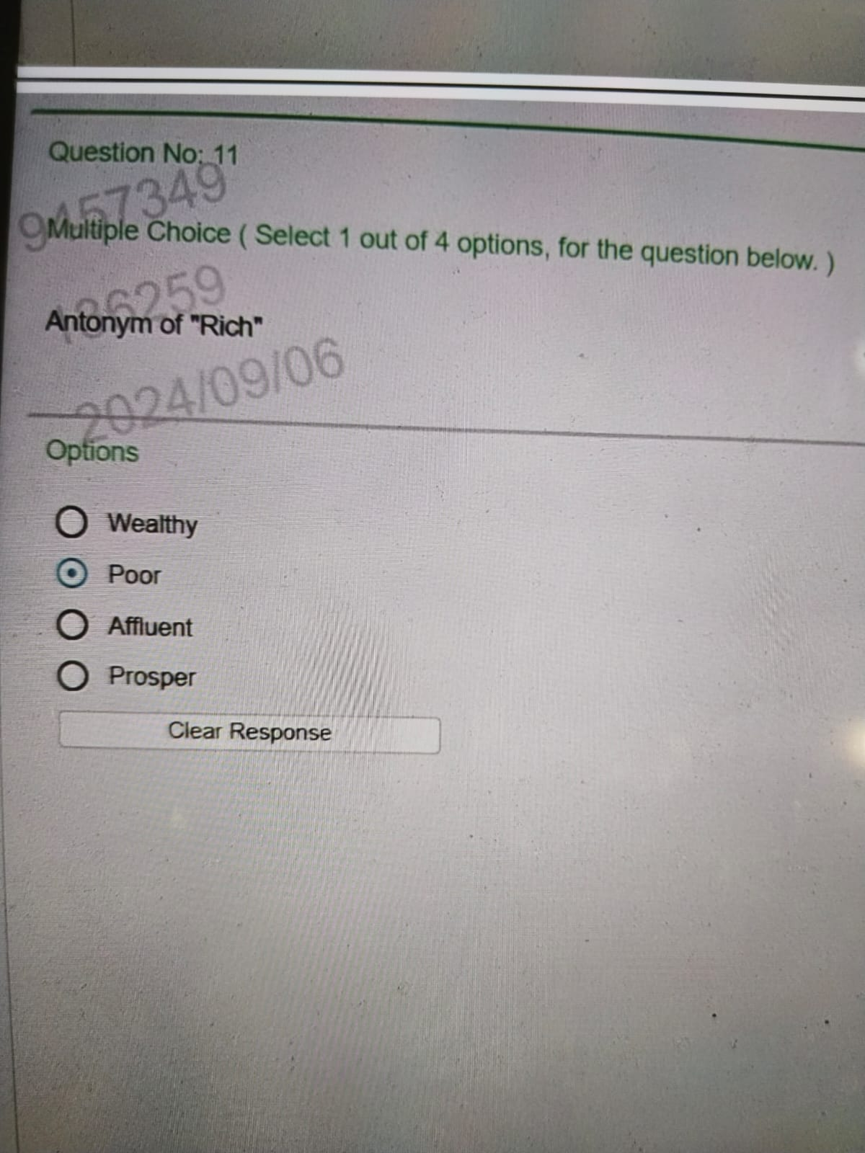

Slide 14
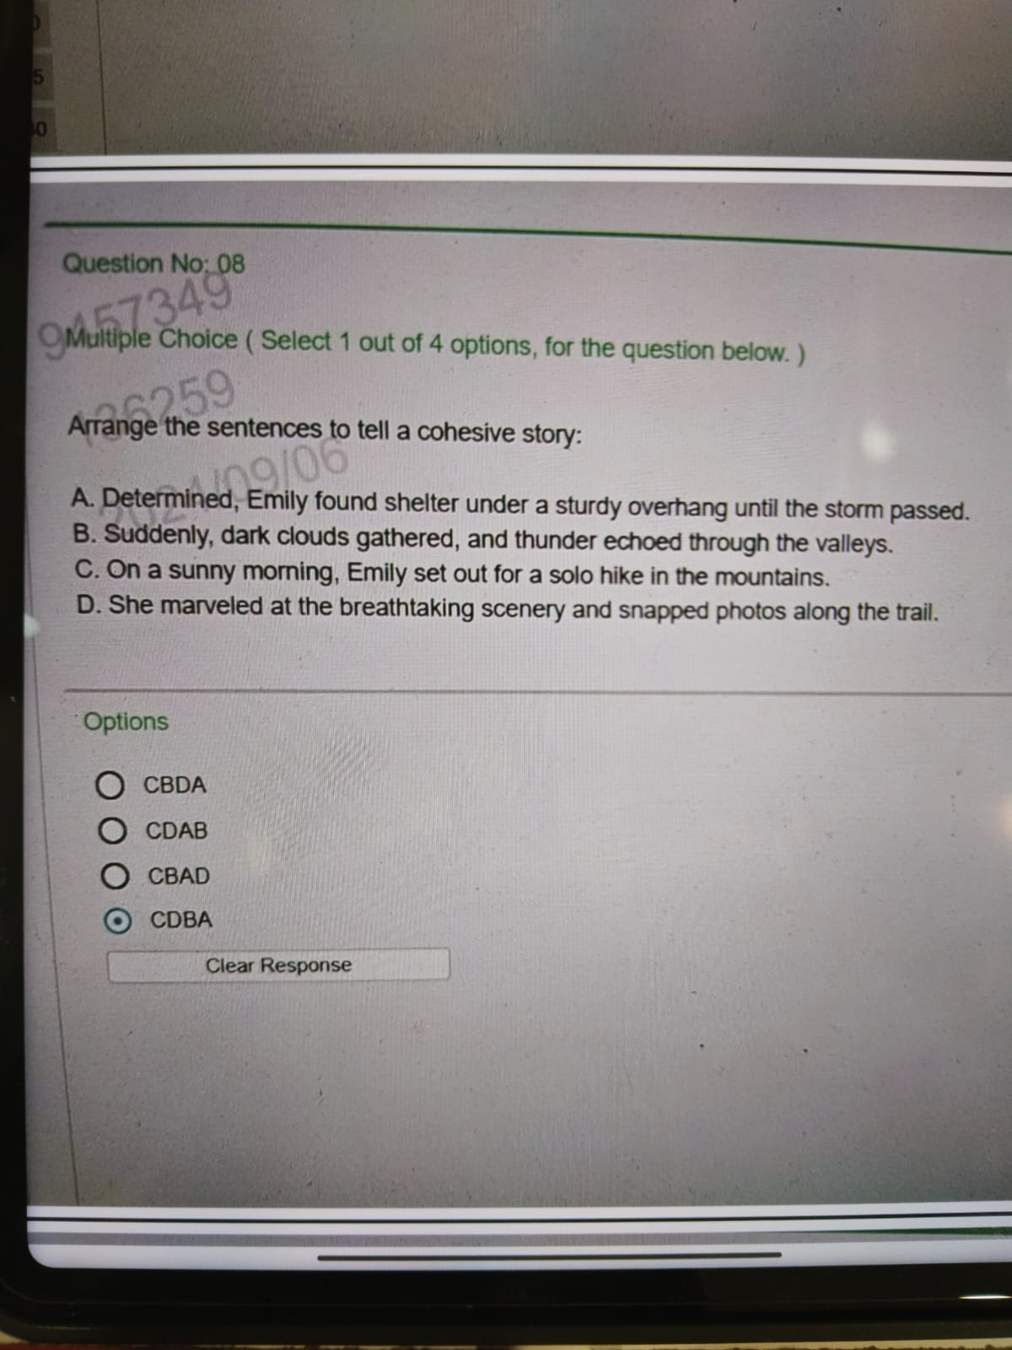

Slide 15
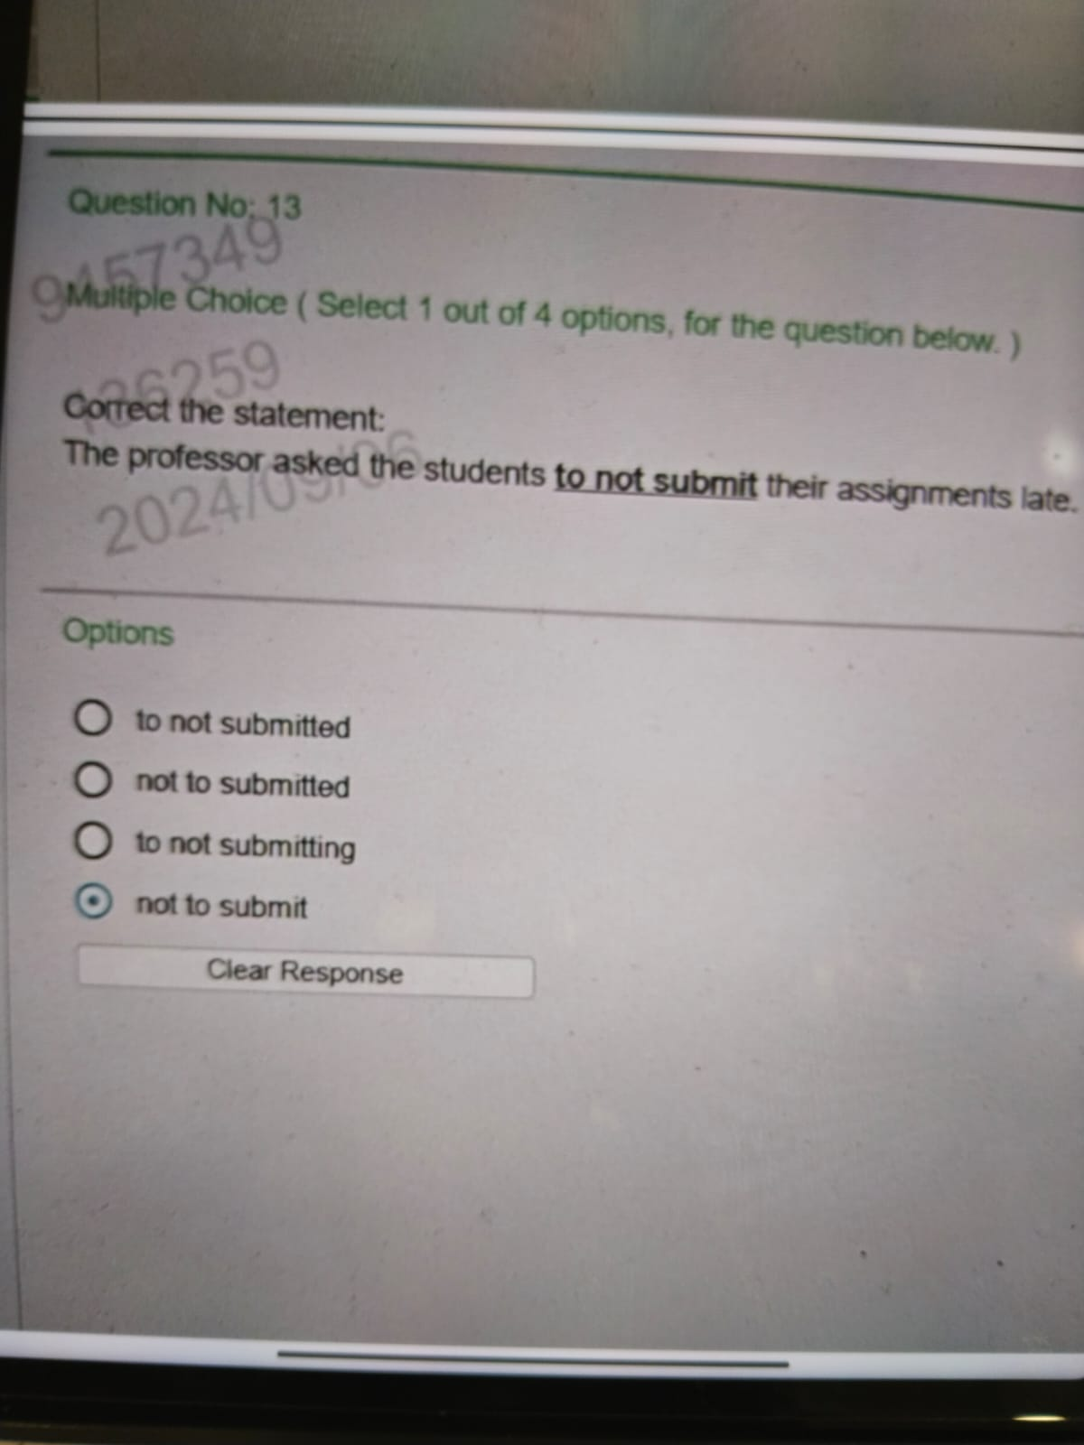


Slide 16
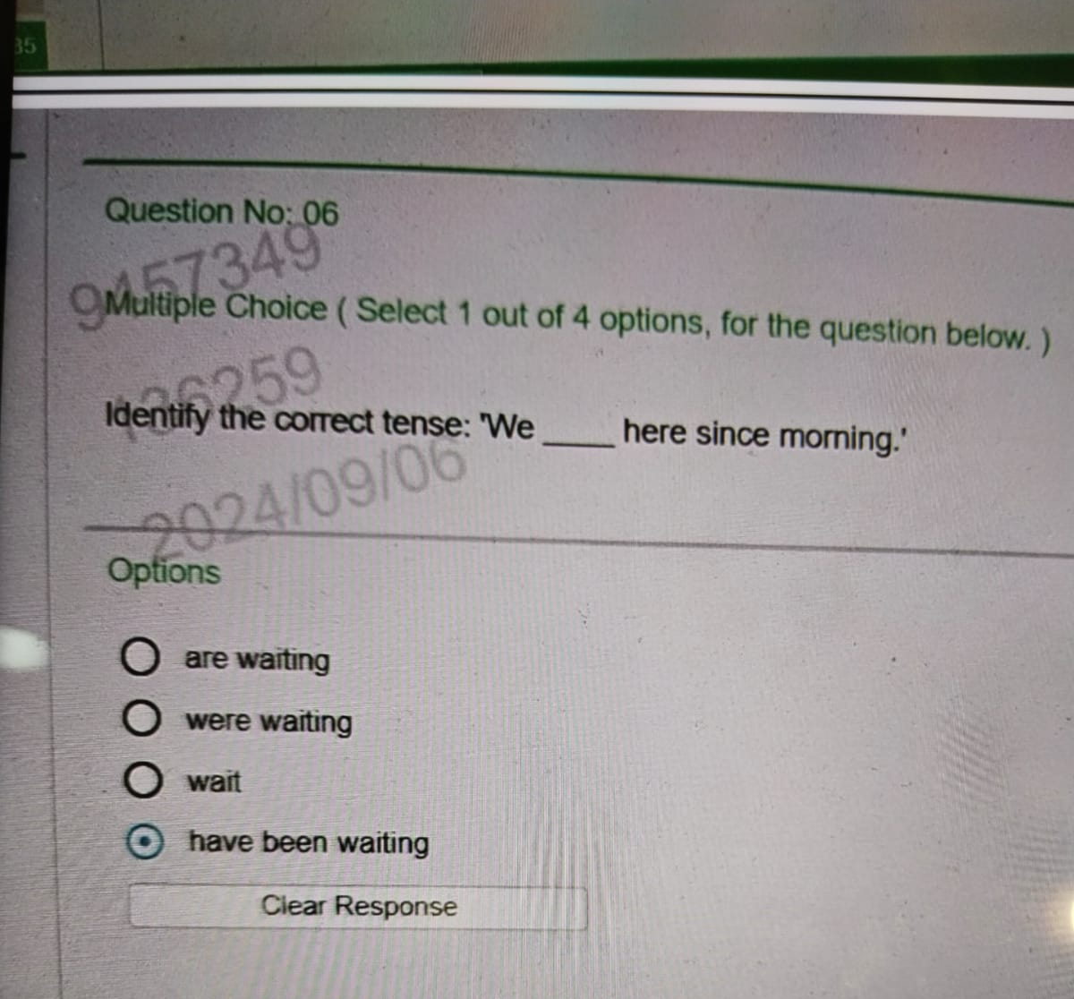

Slide 17
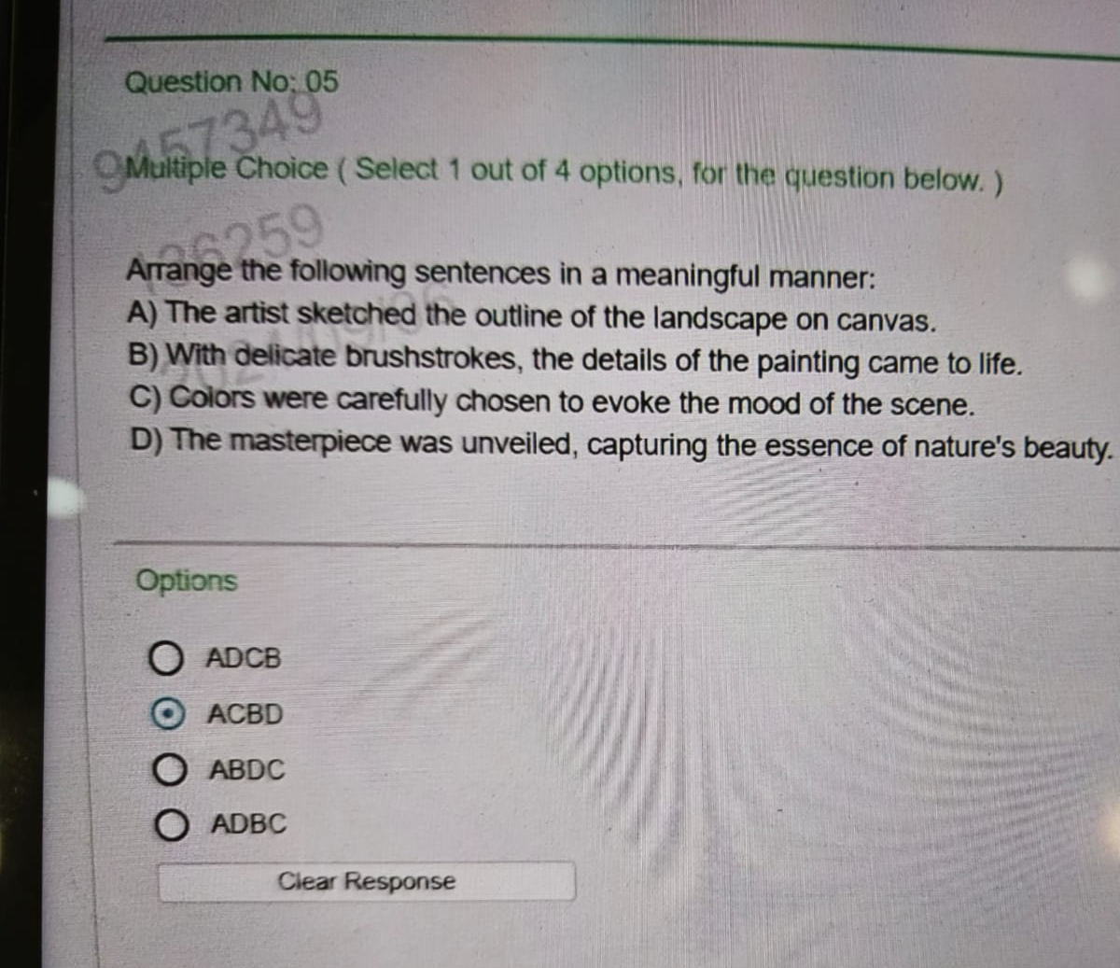


Slide 18
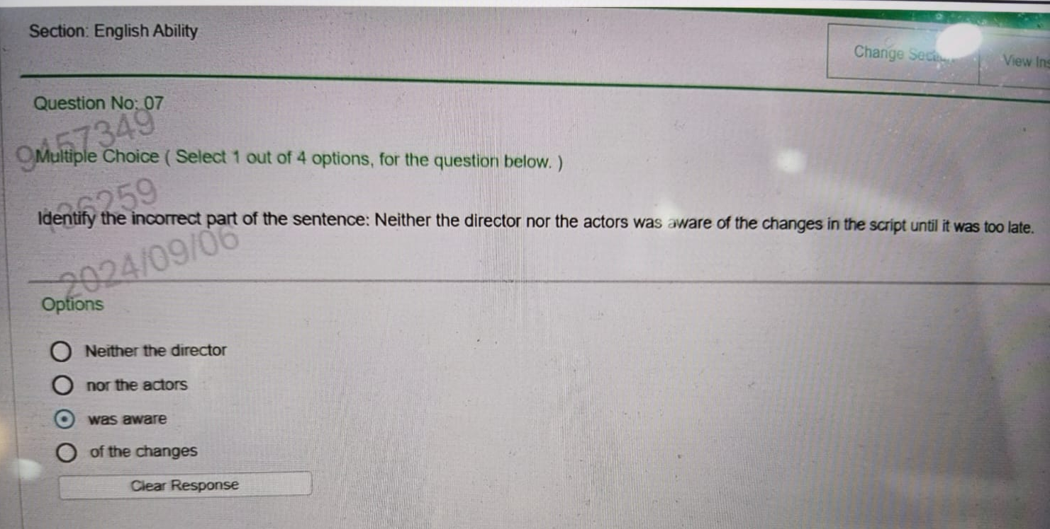


Slide 19
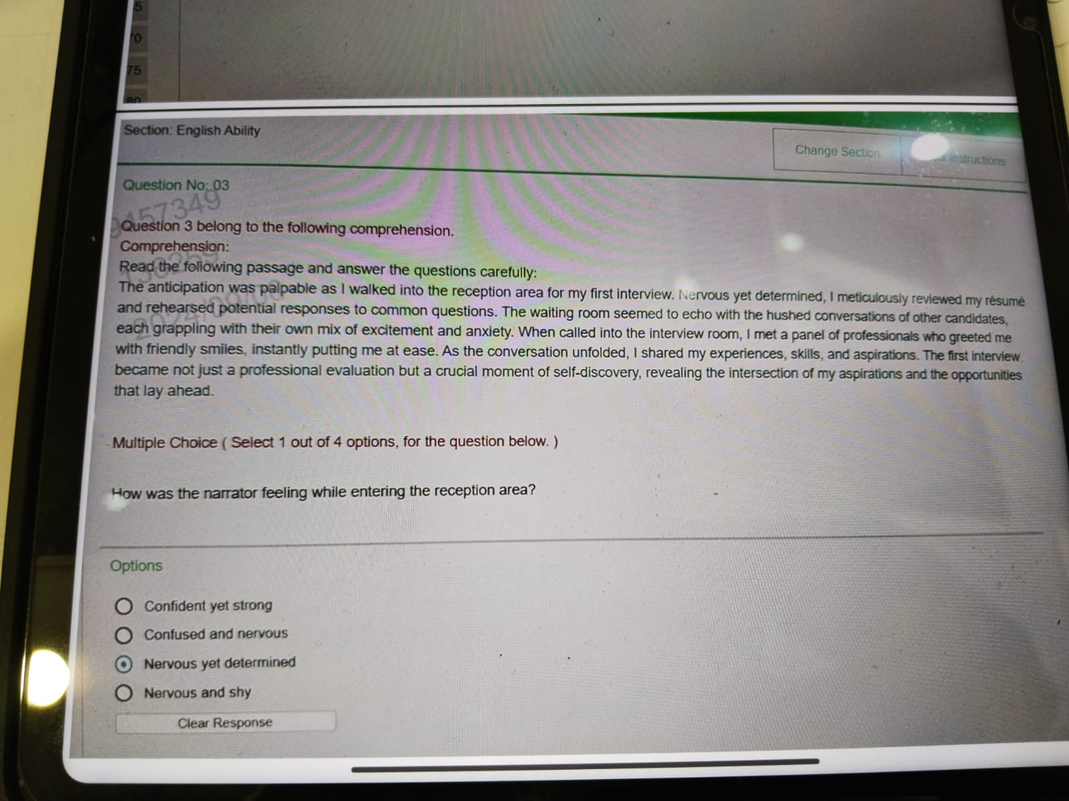


Slide 20
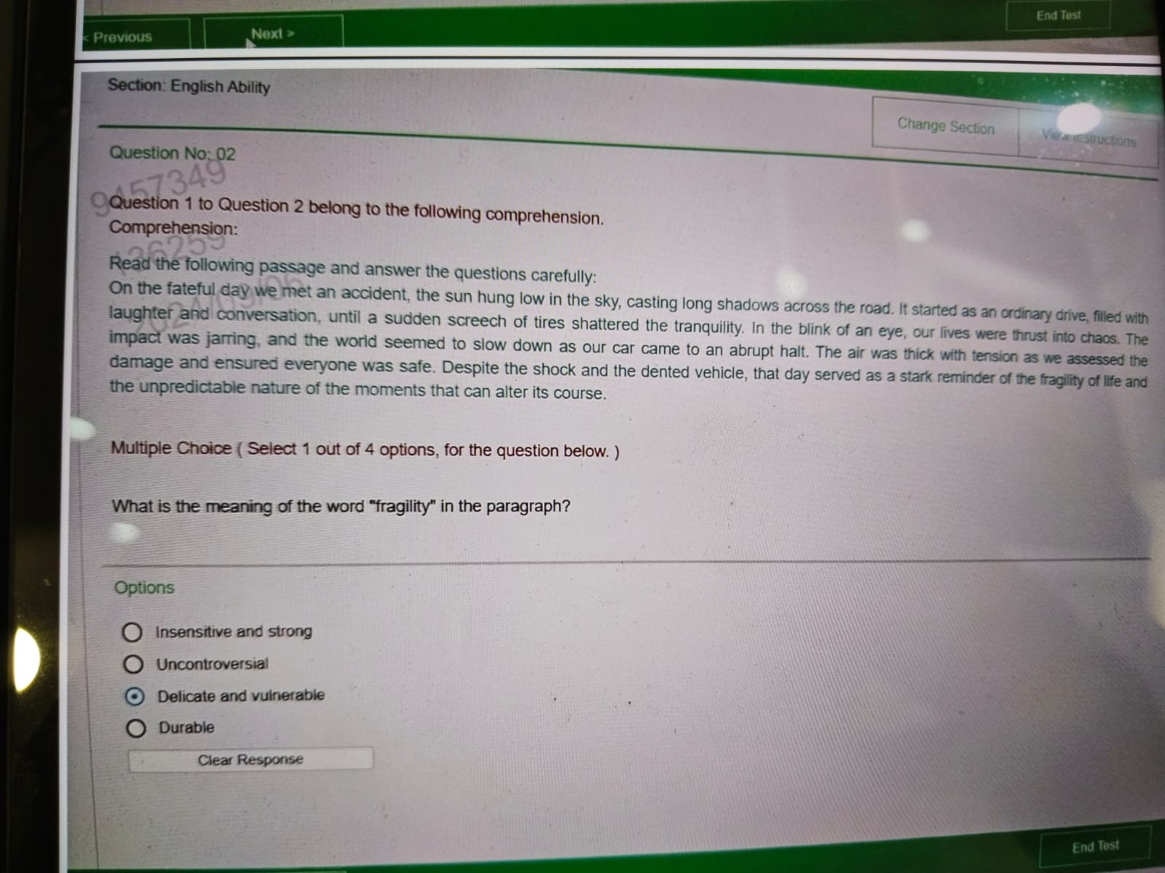


Slide 21
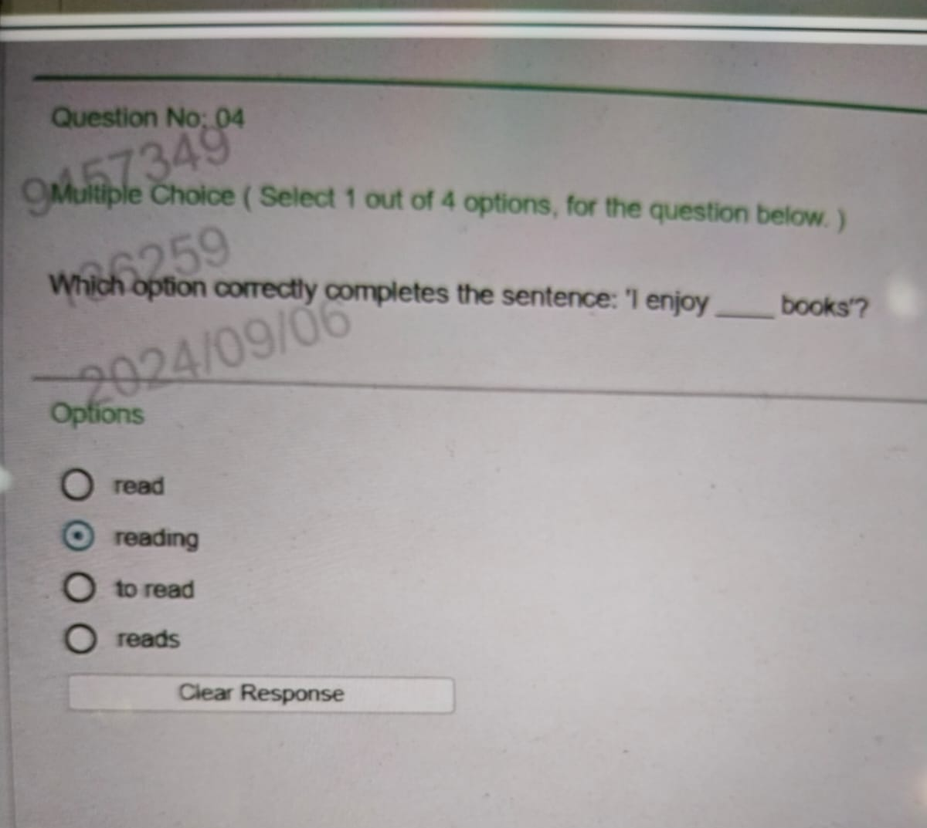


Slide 22
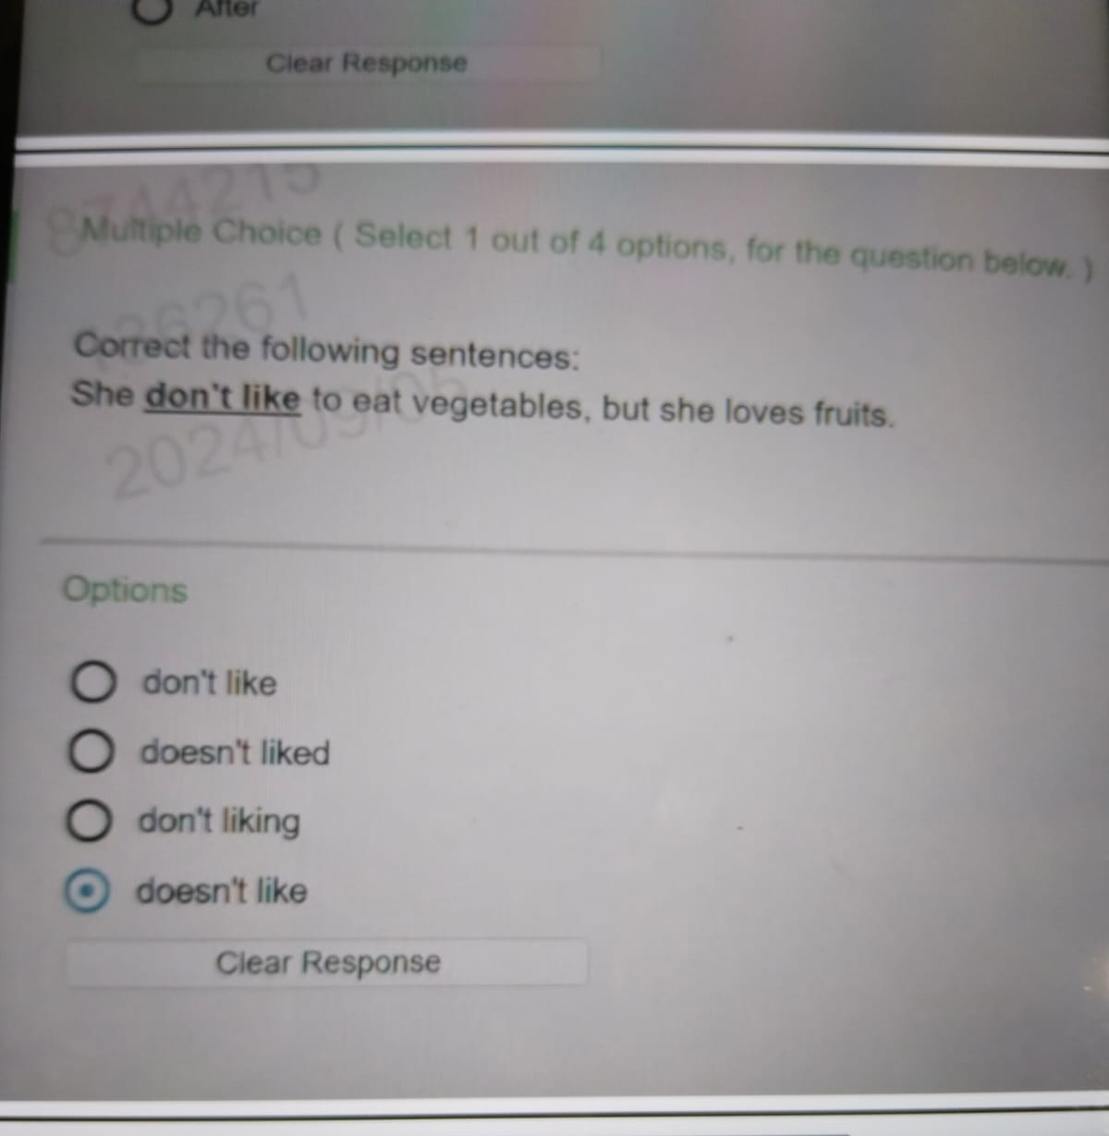


Slide 23
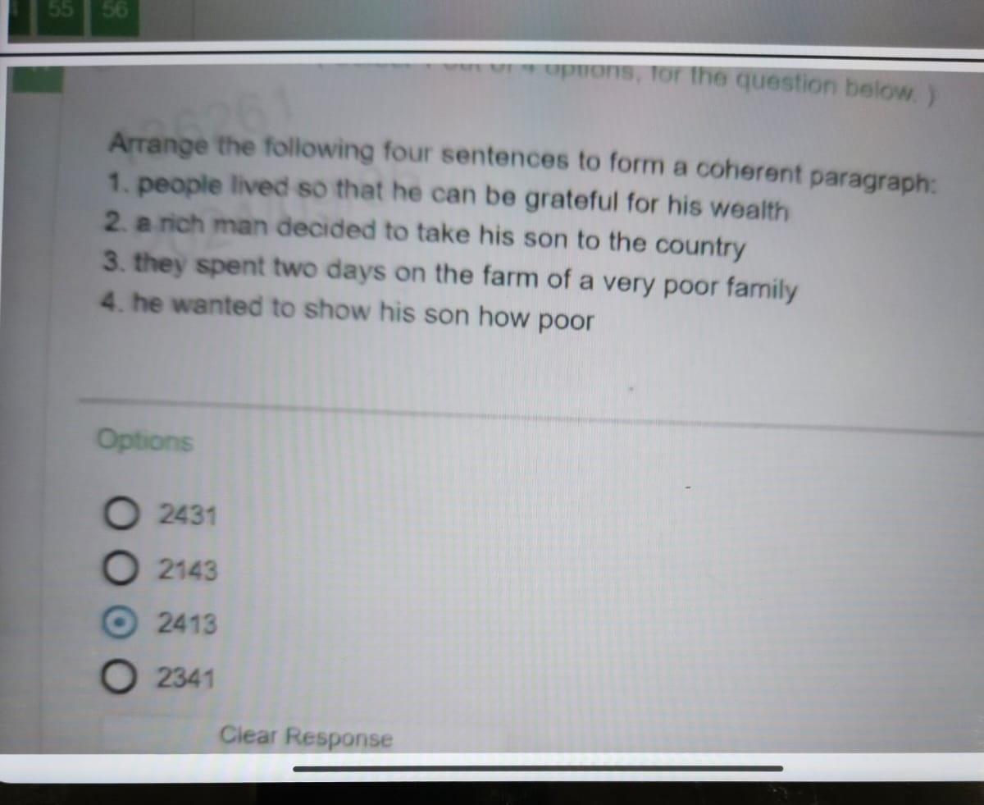


Slide 24
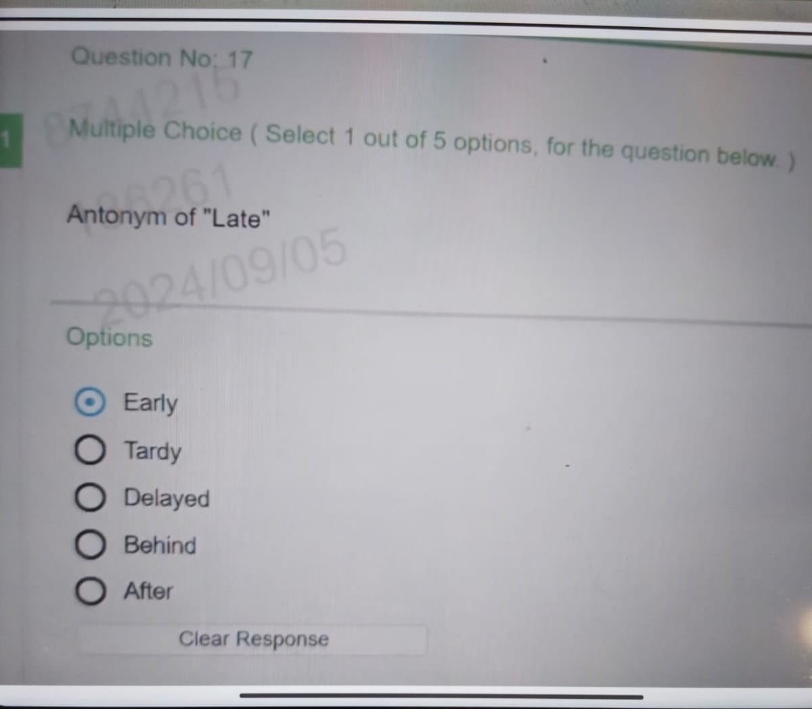

Slide 25
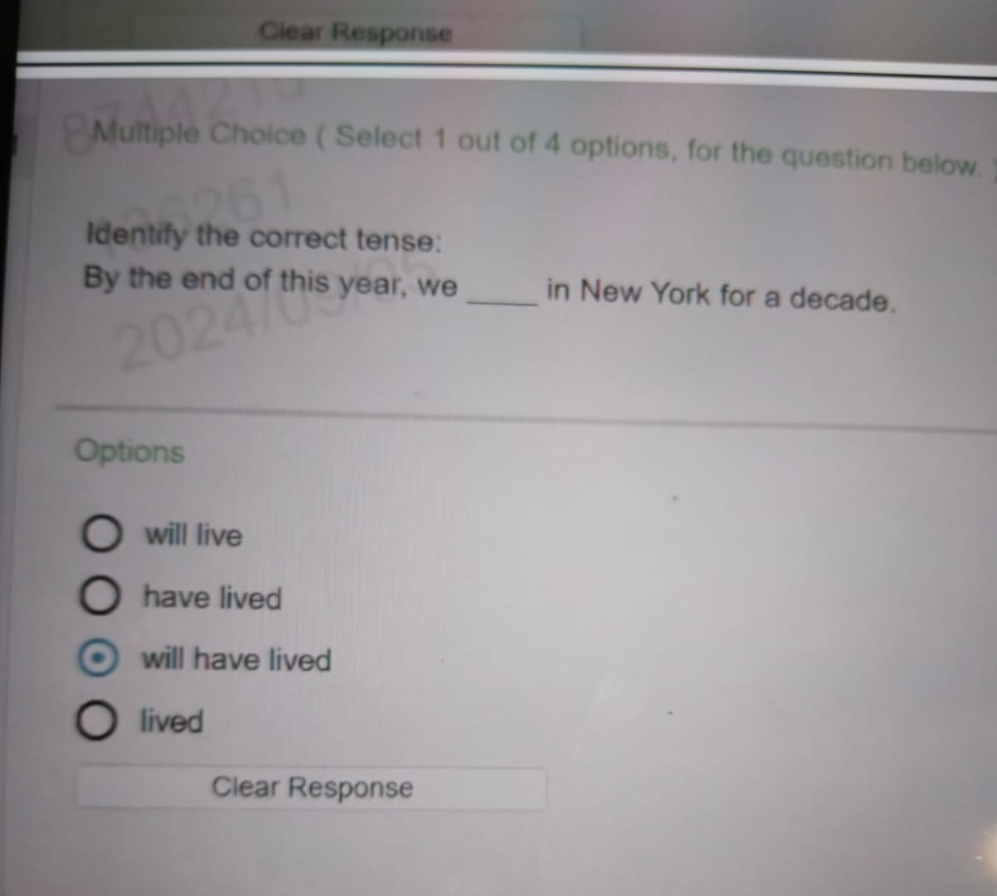


Slide 26
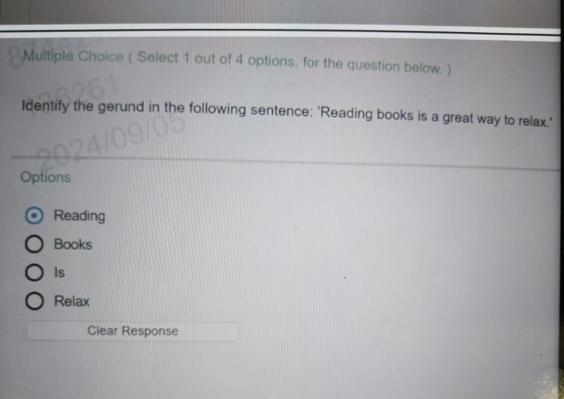


Slide 27
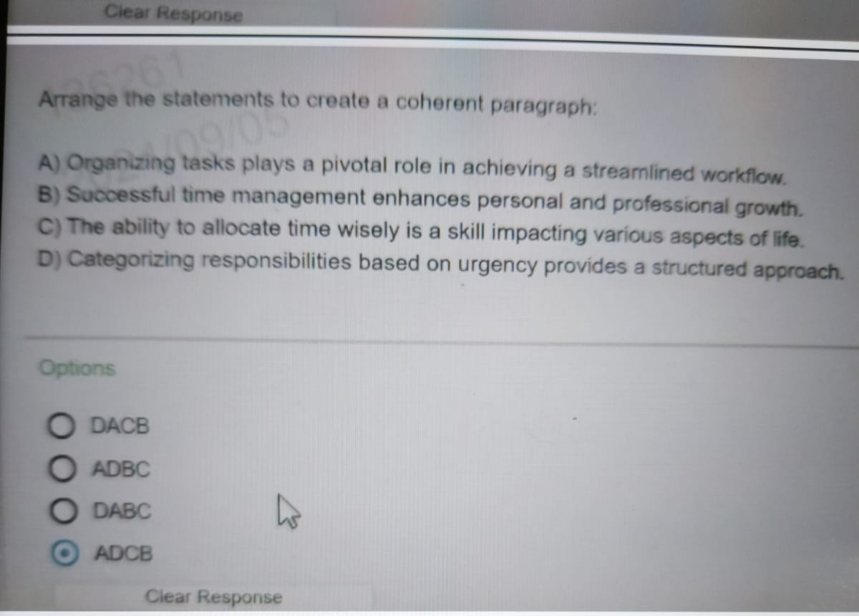


Slide 28
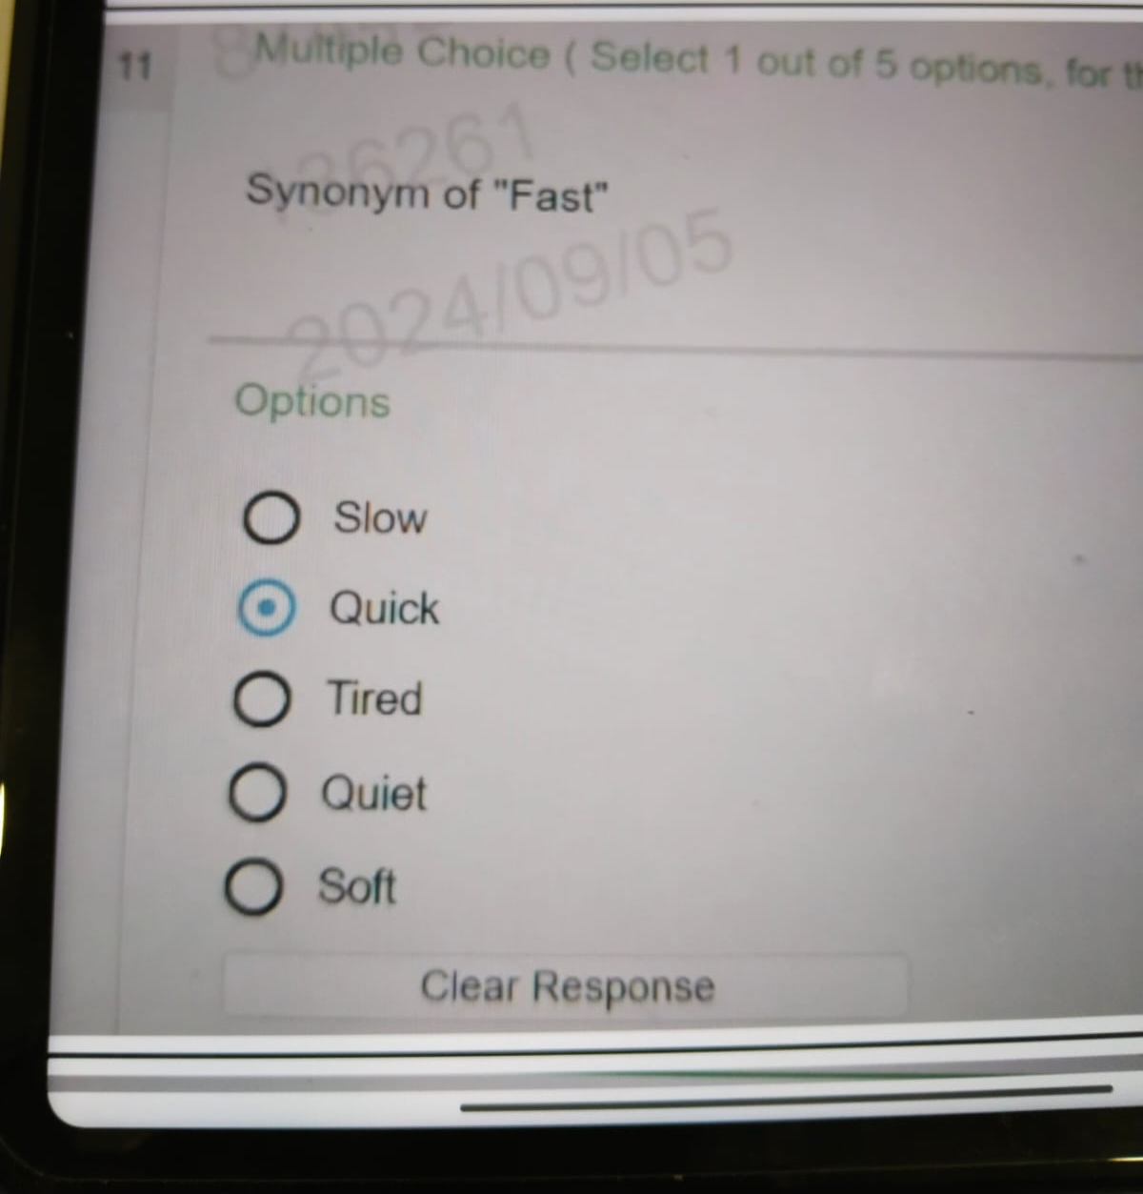

Slide 29
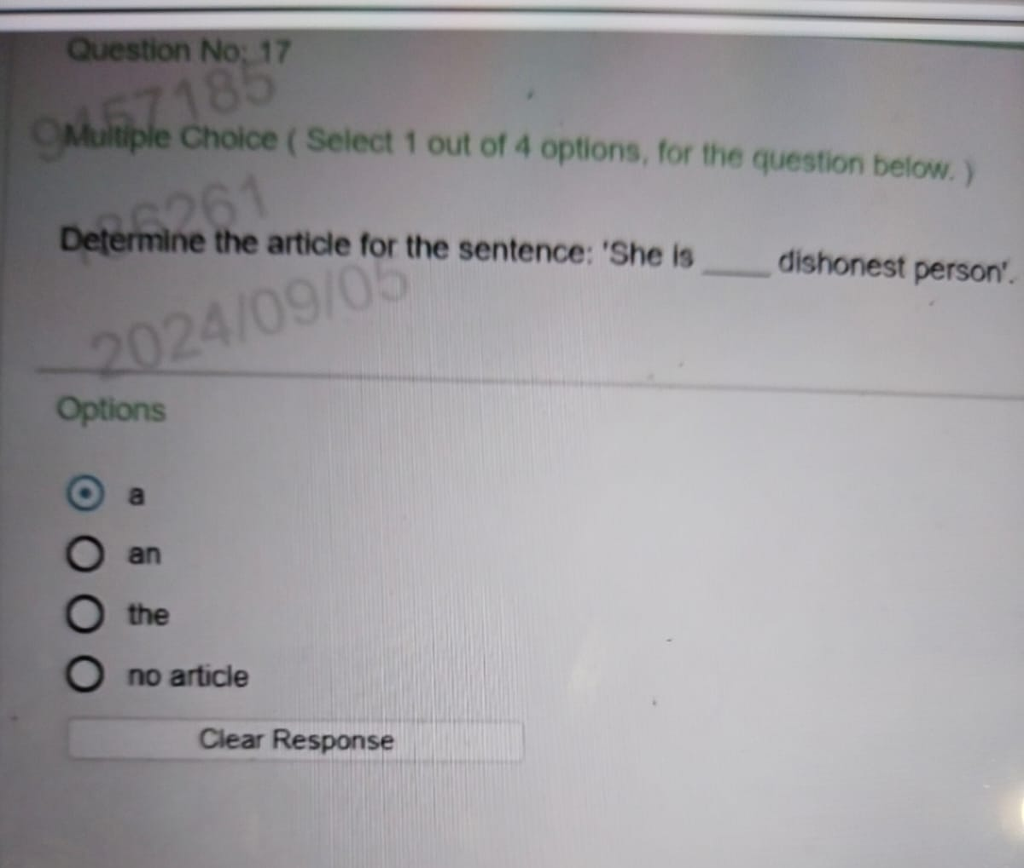


Slide 30
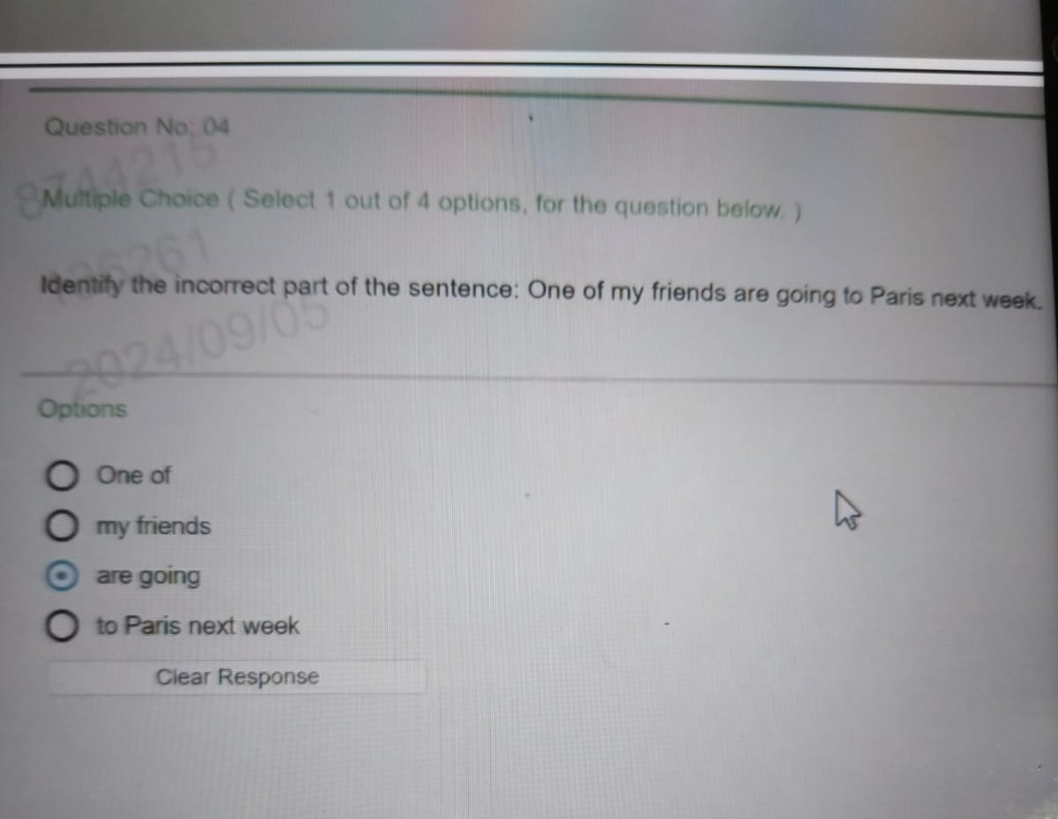


Slide 31
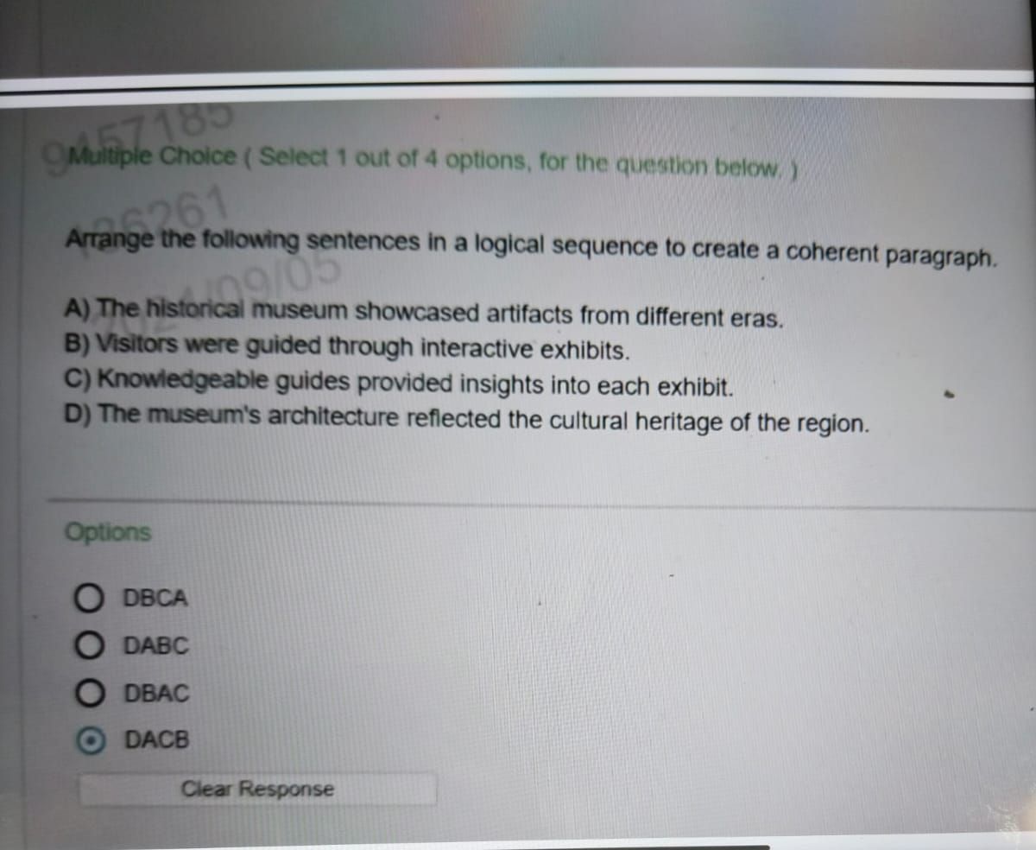


Slide 32
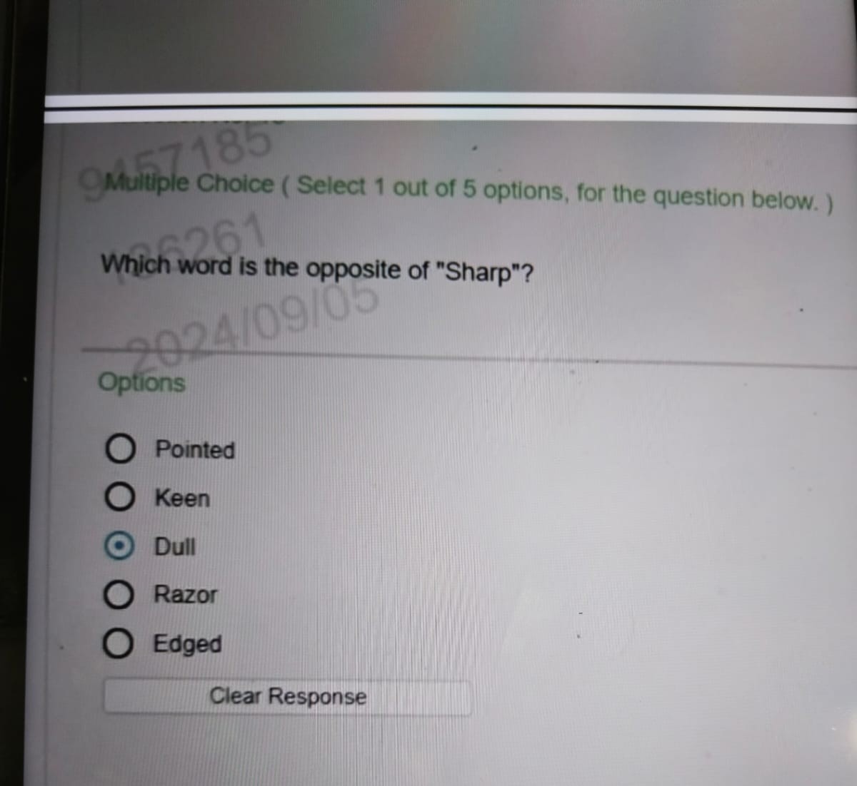


Slide 33
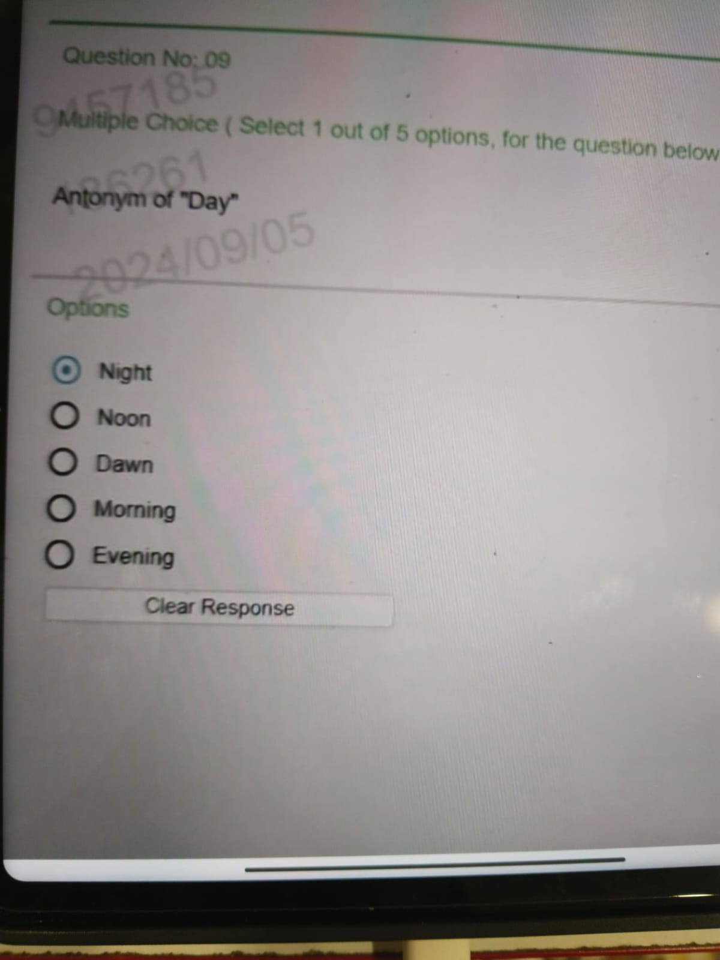

Slide 34
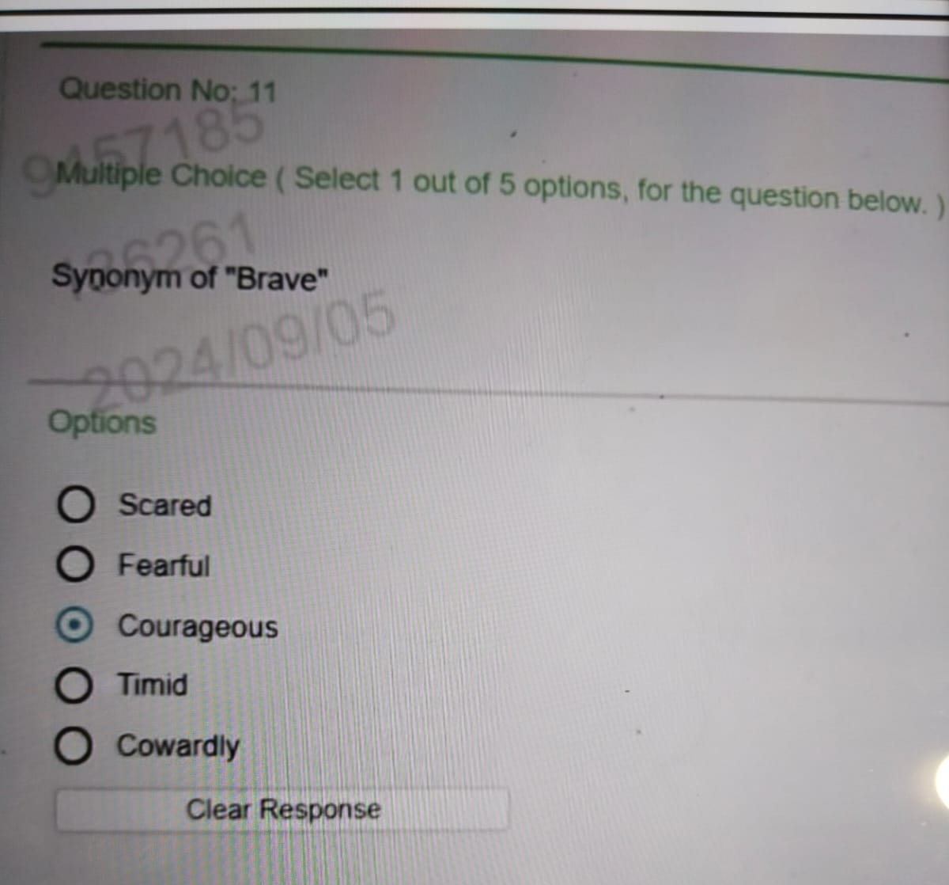


Slide 35
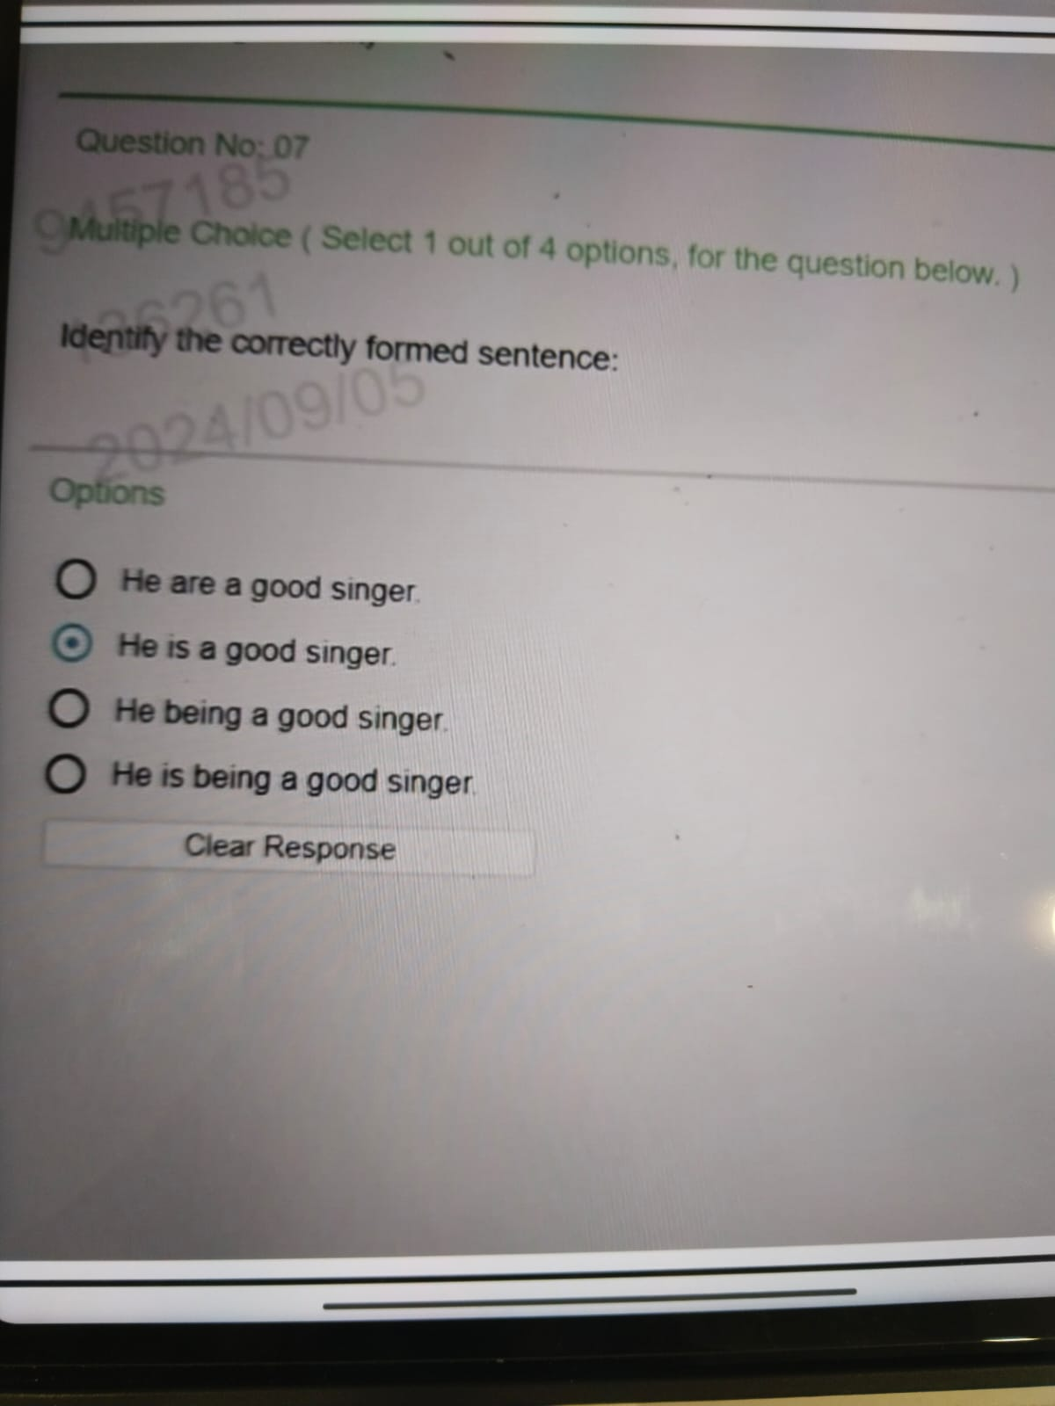


Slide 36
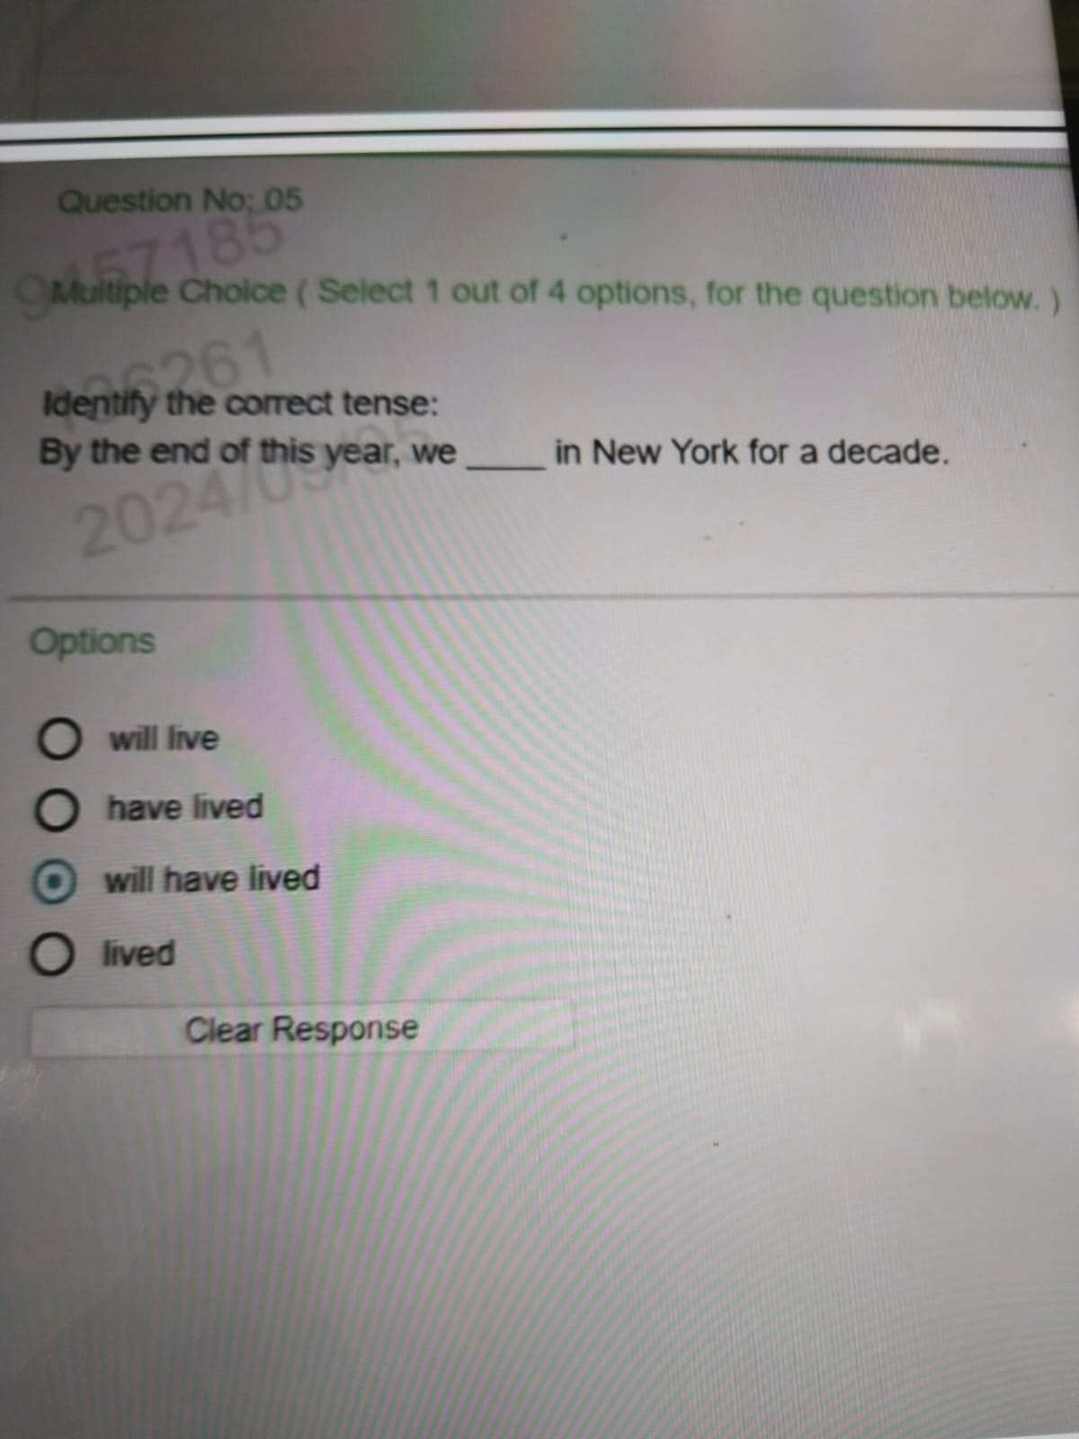


Slide 37
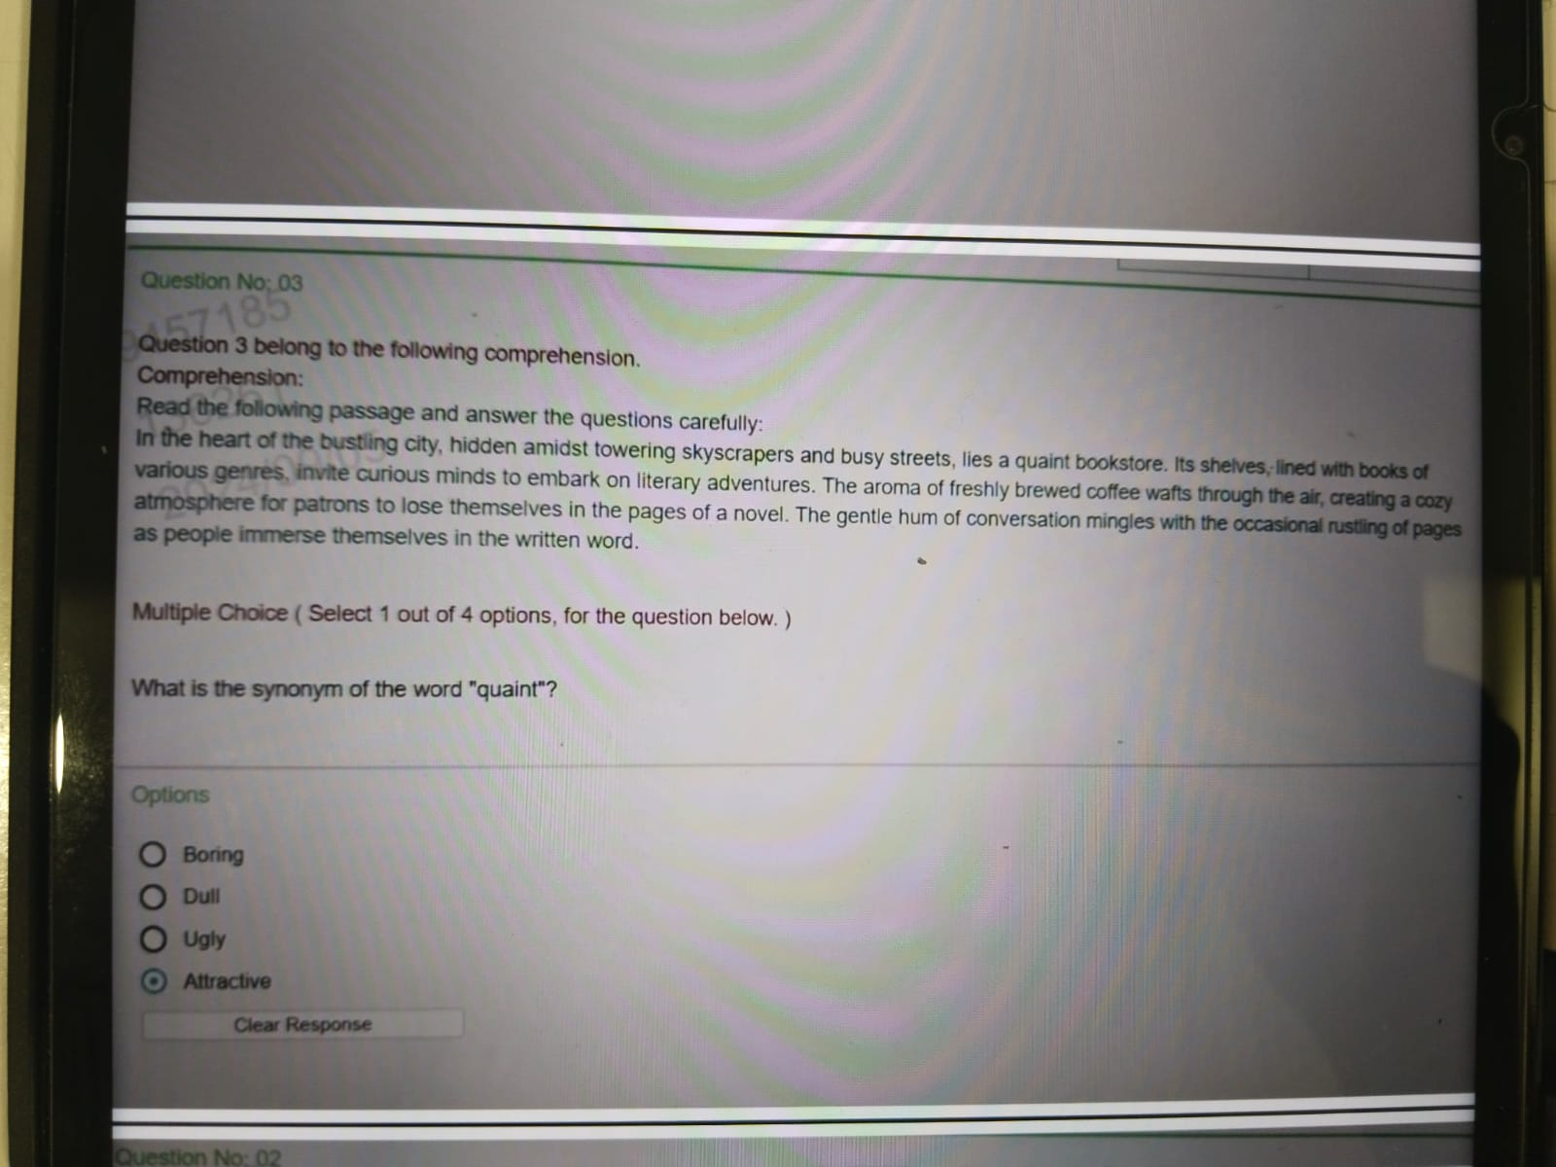


Slide 38
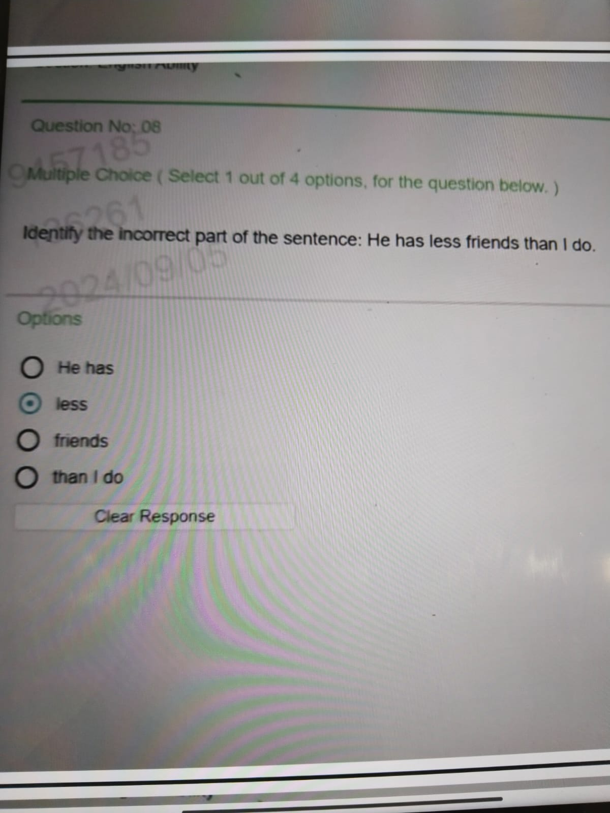


Slide 39
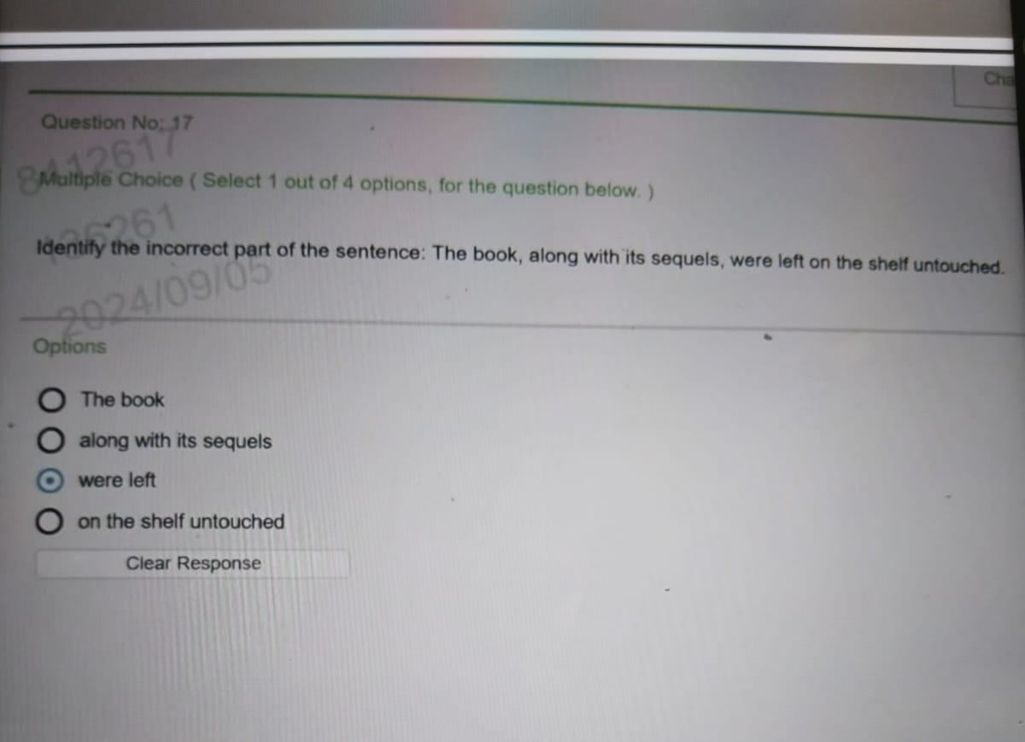


Slide 40
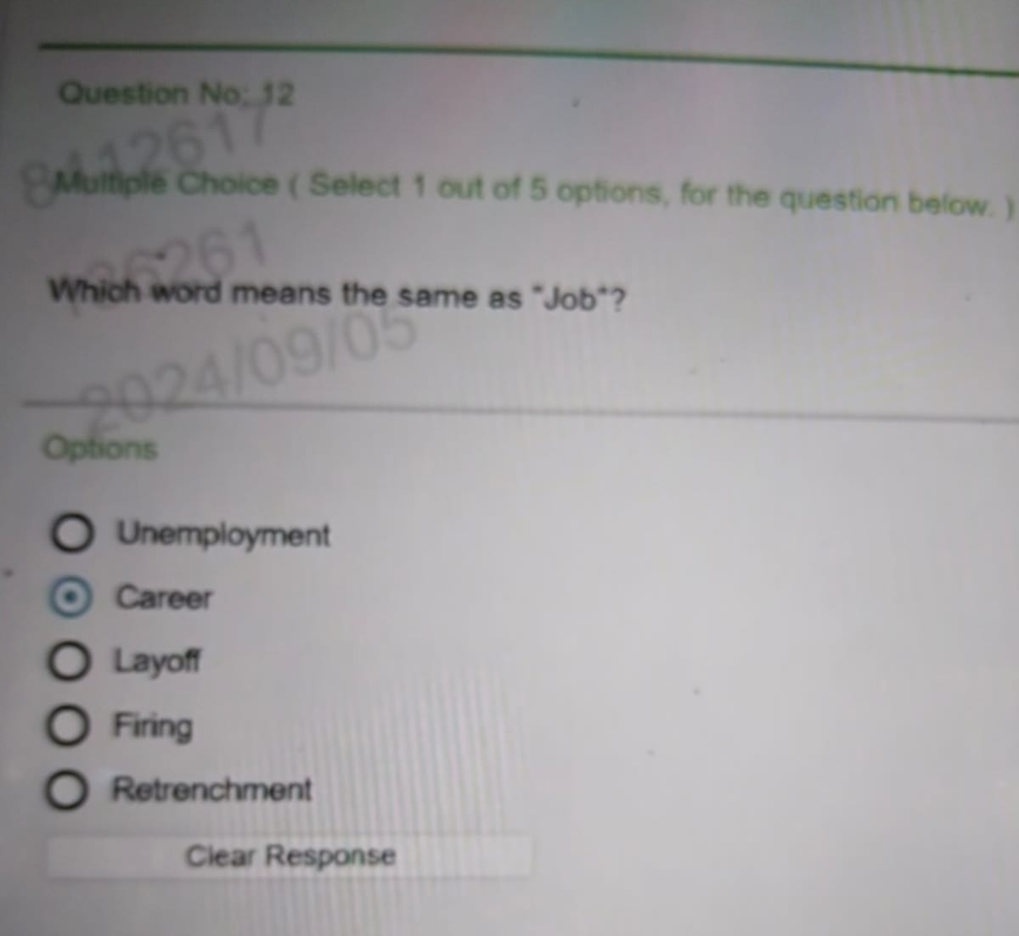


Slide 41
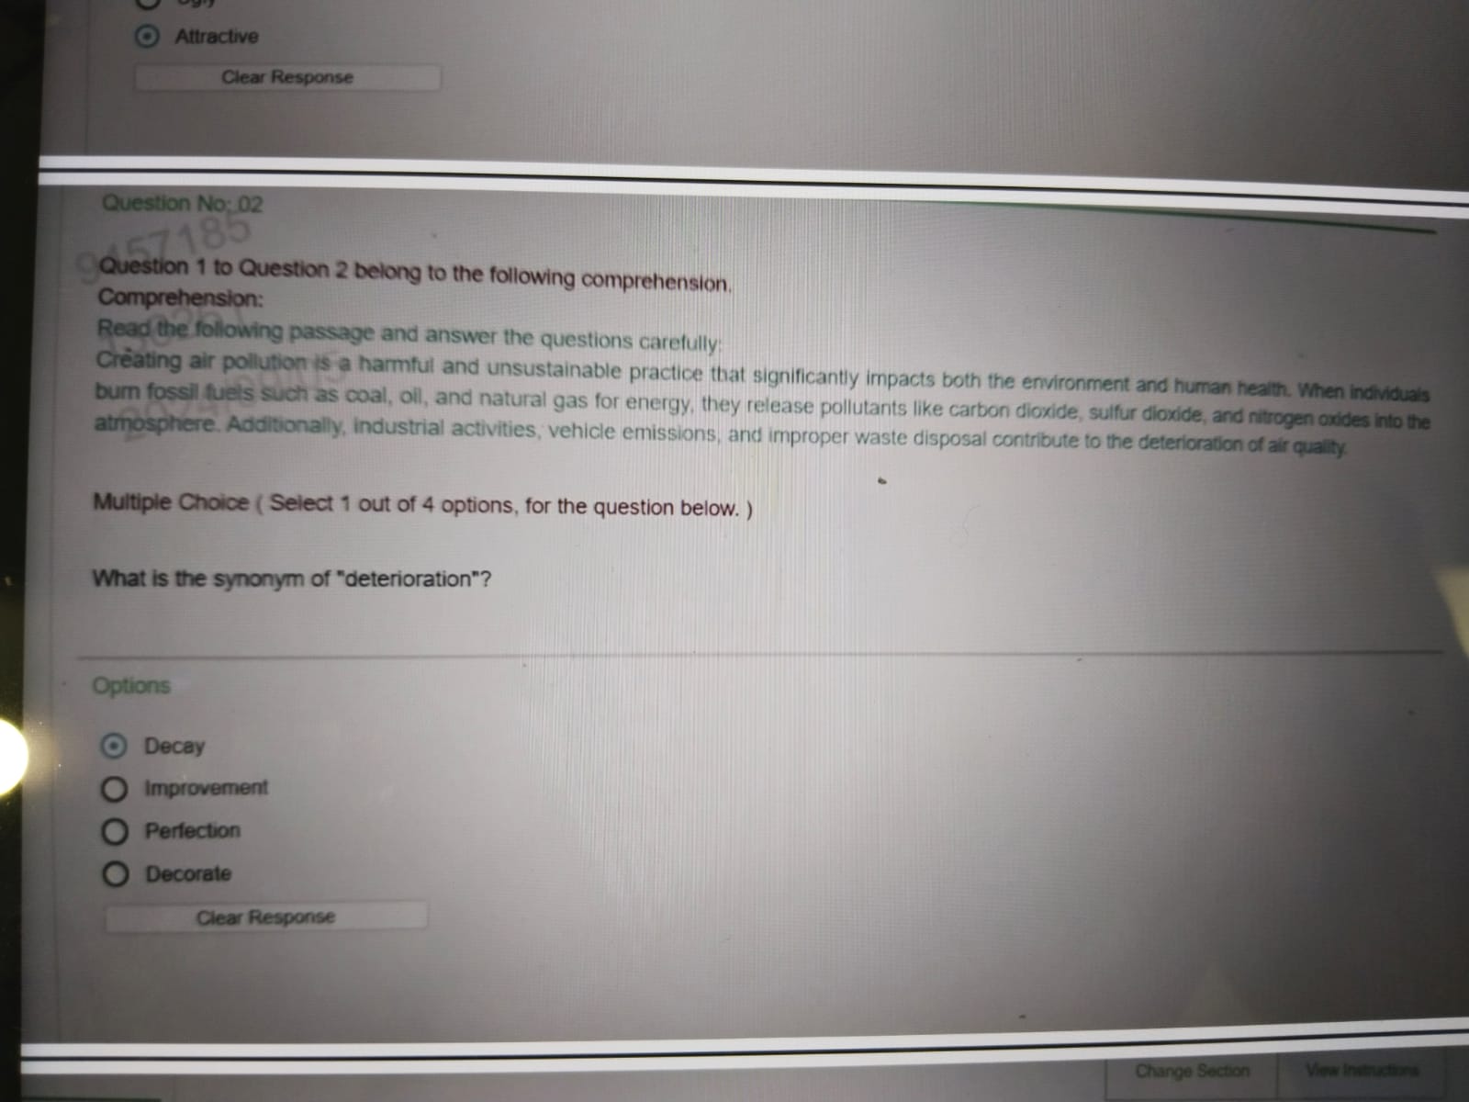


Slide 42
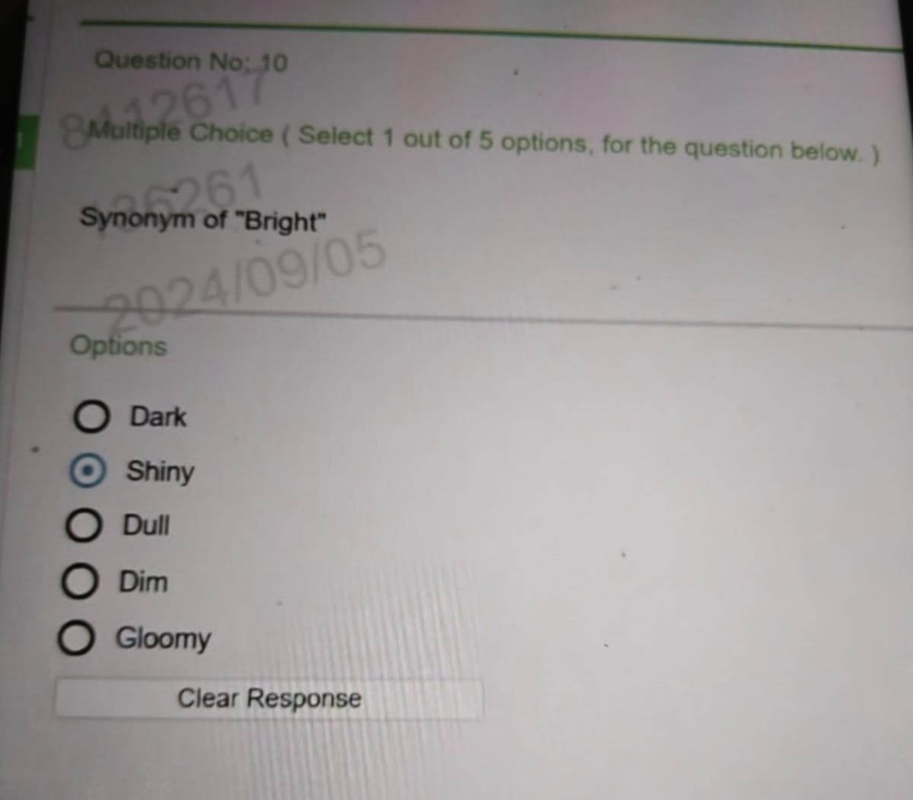


Slide 43
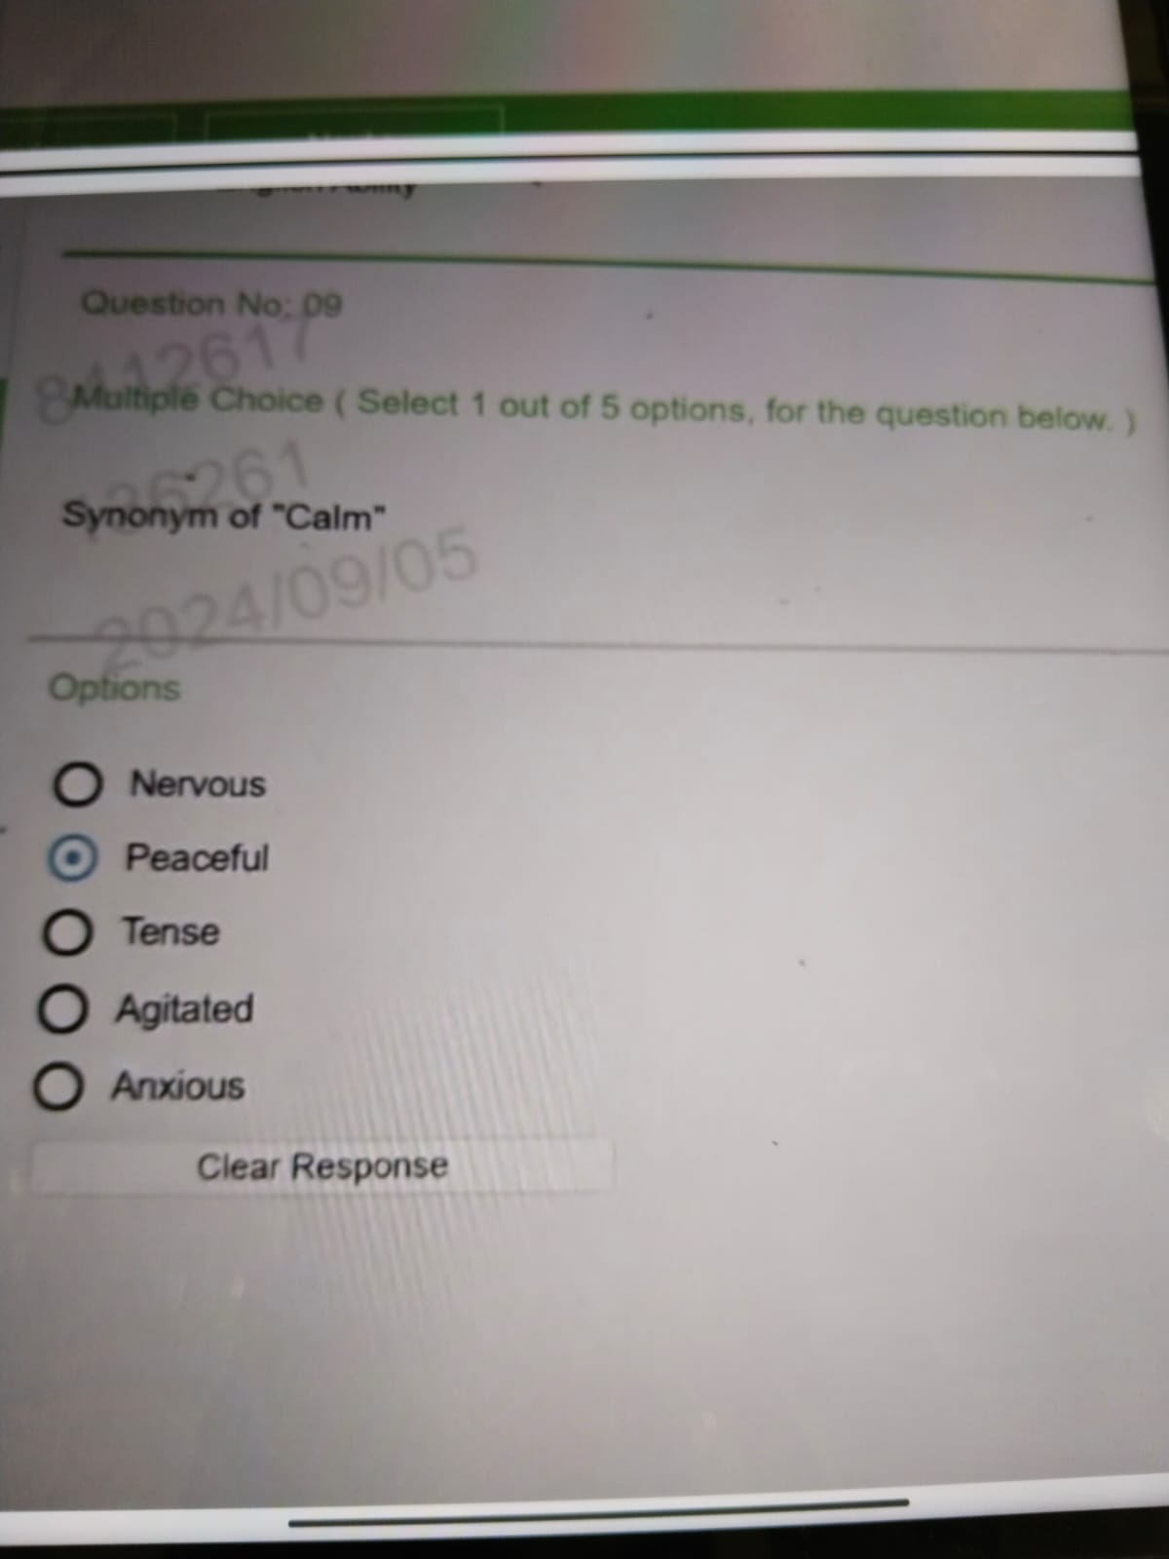


Slide 44
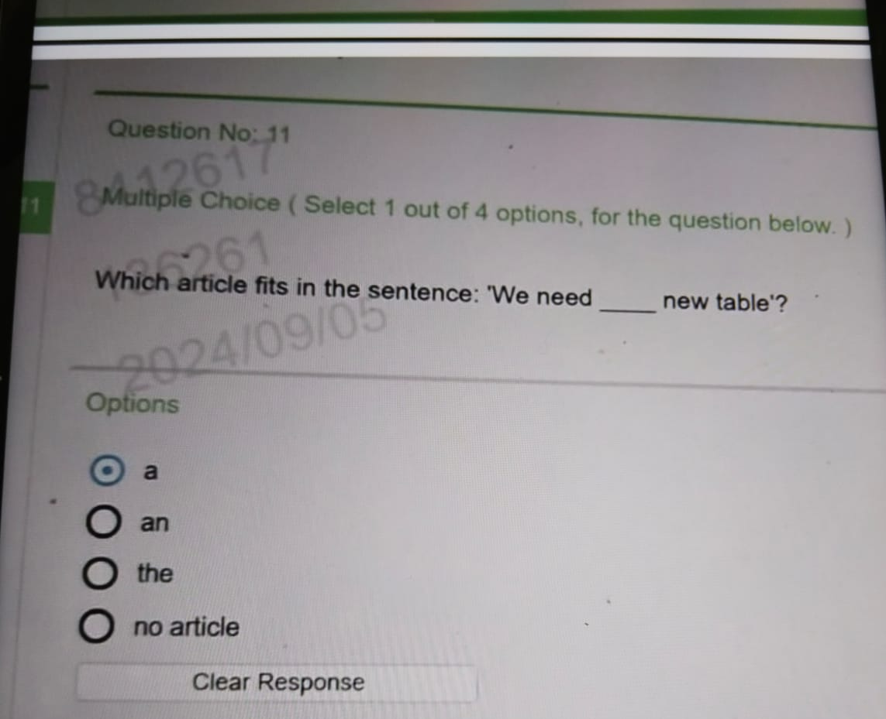


Slide 45
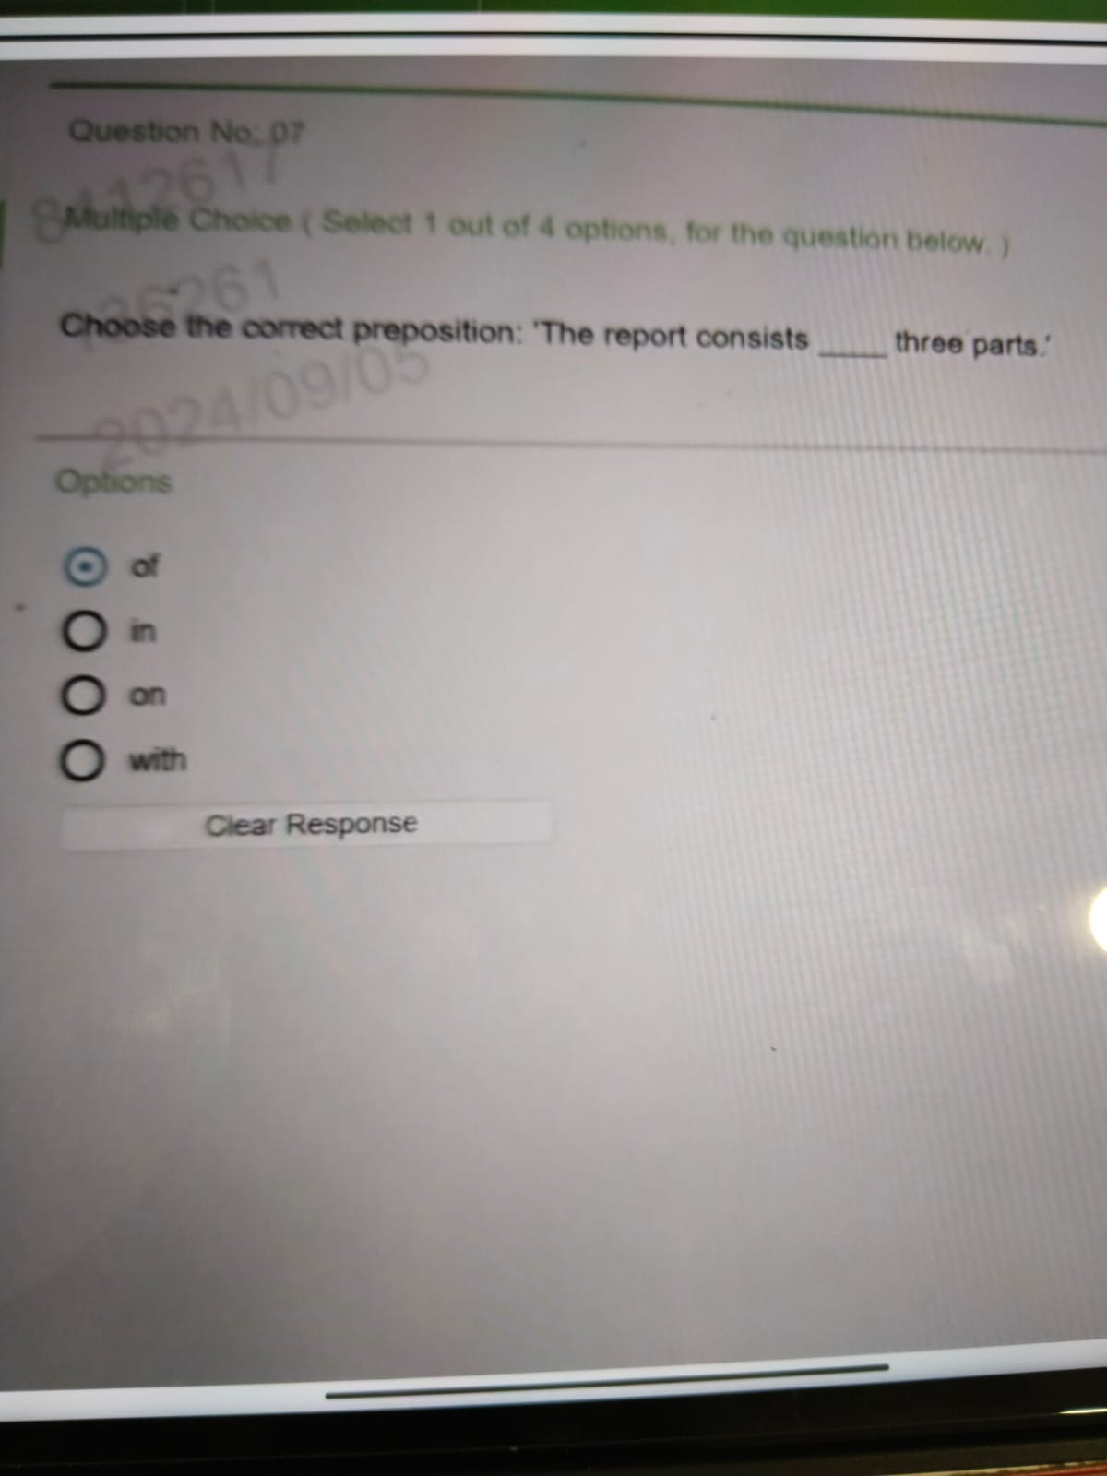


Slide 46
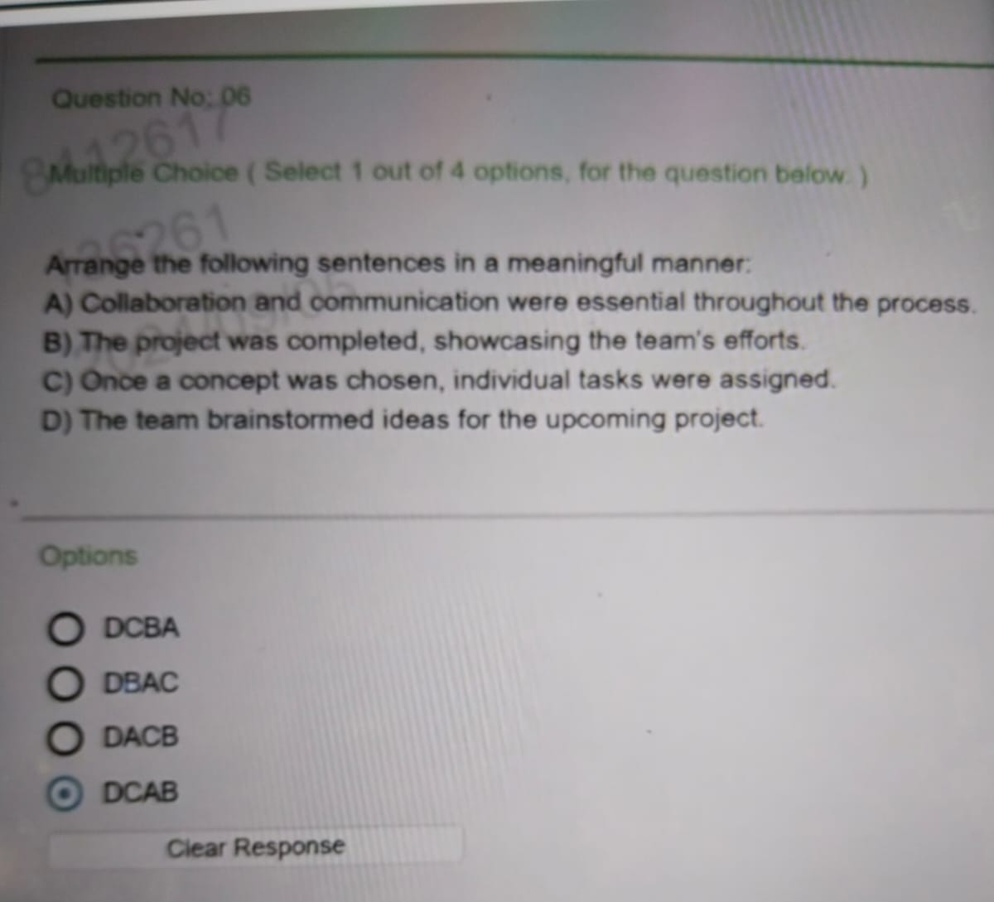


Slide 47
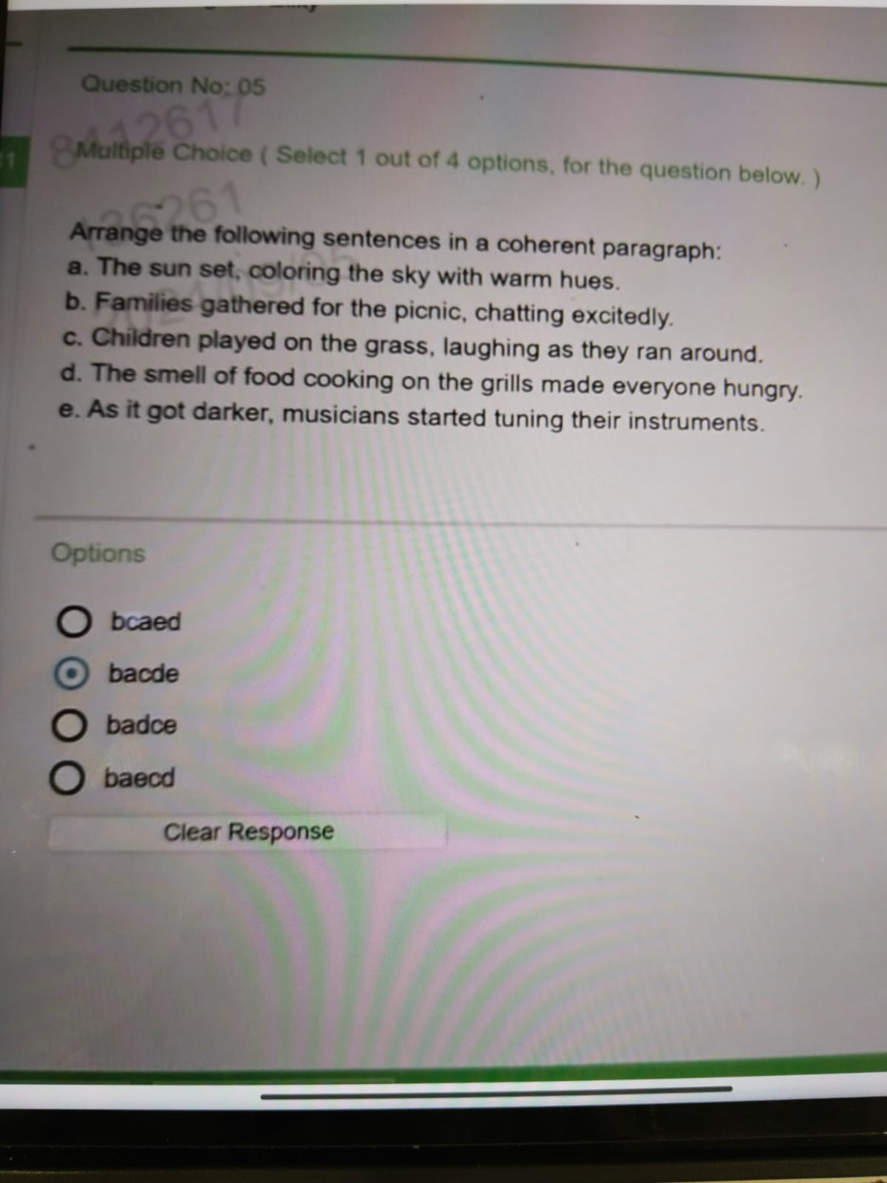

Slide 48
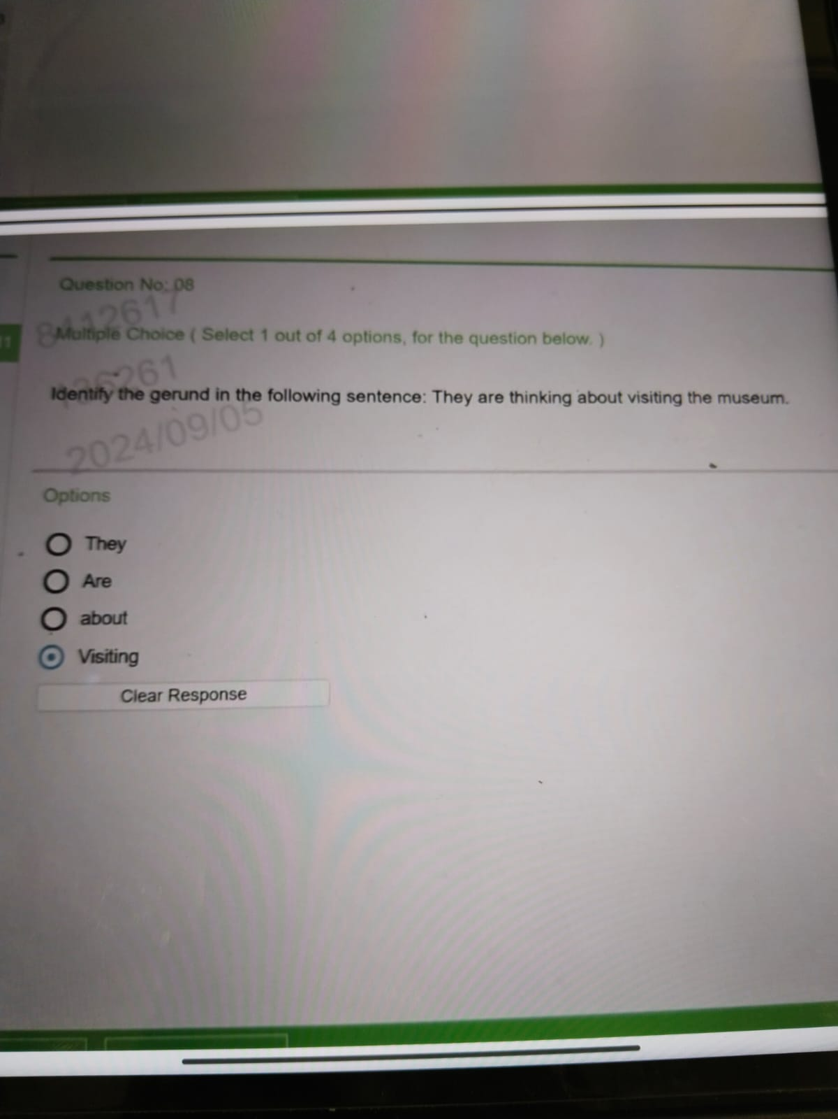


Slide 49
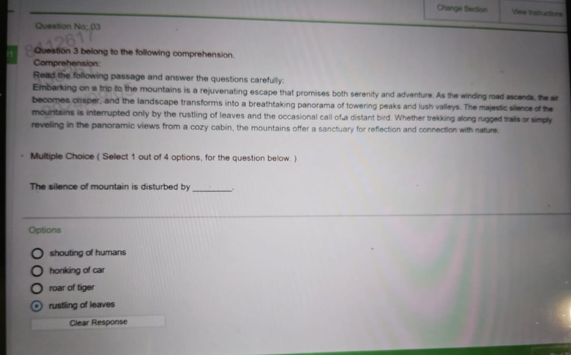

Slide 50
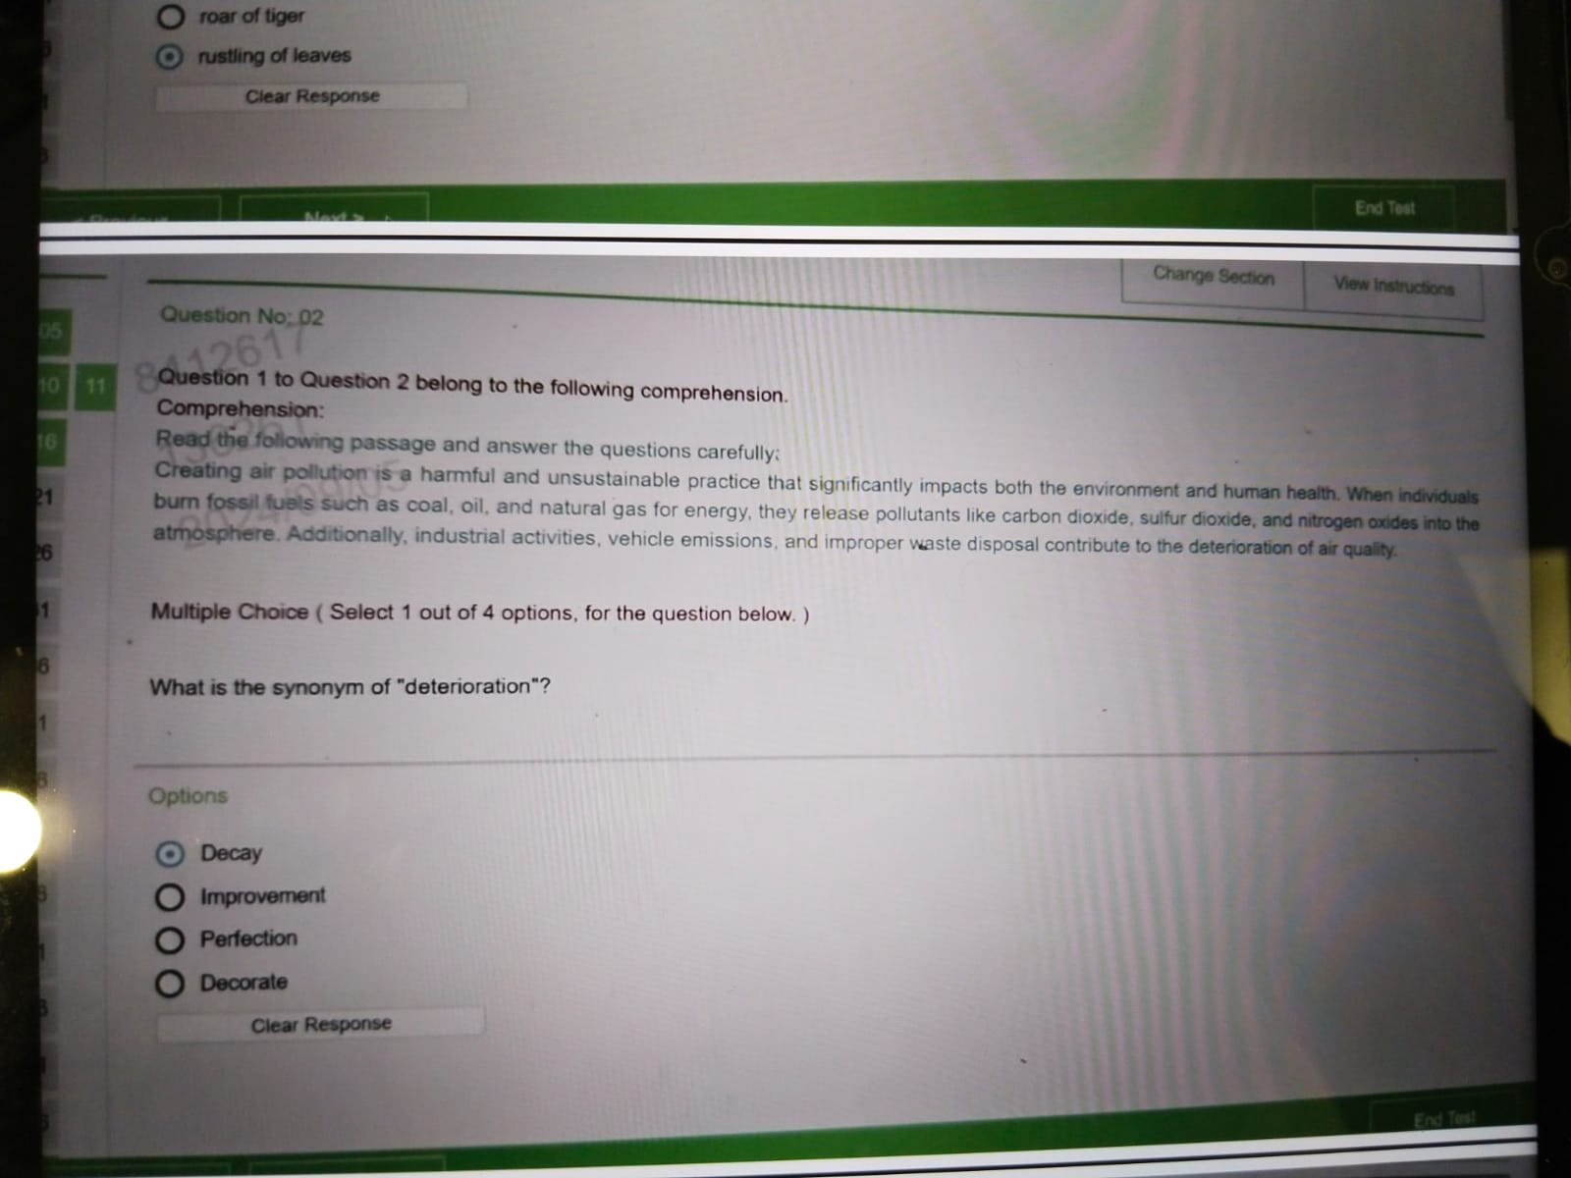


Slide 51
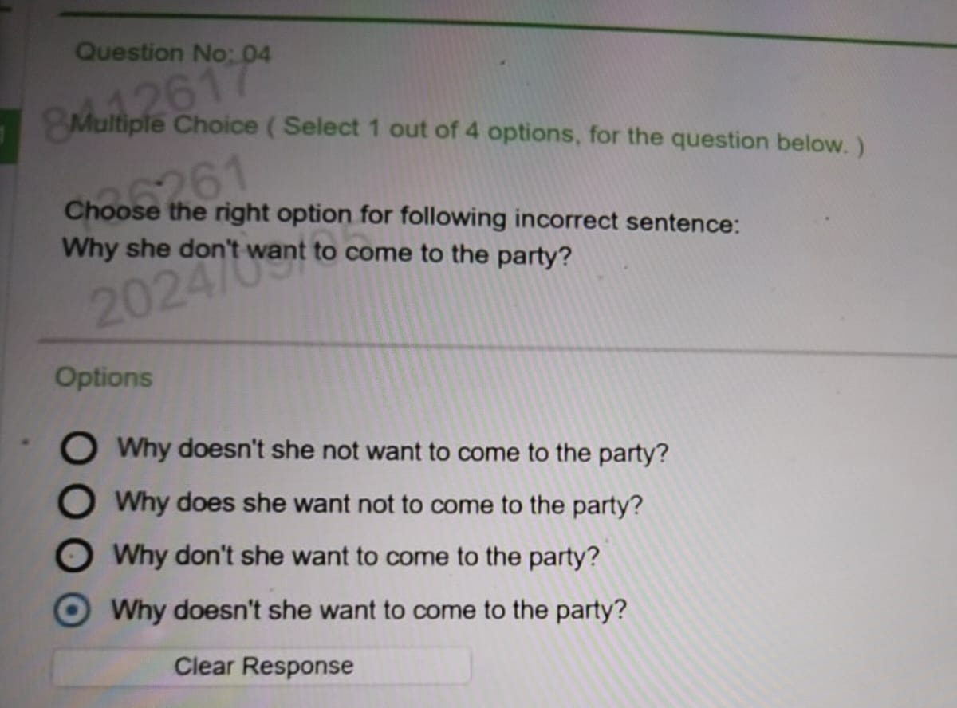


Slide 52
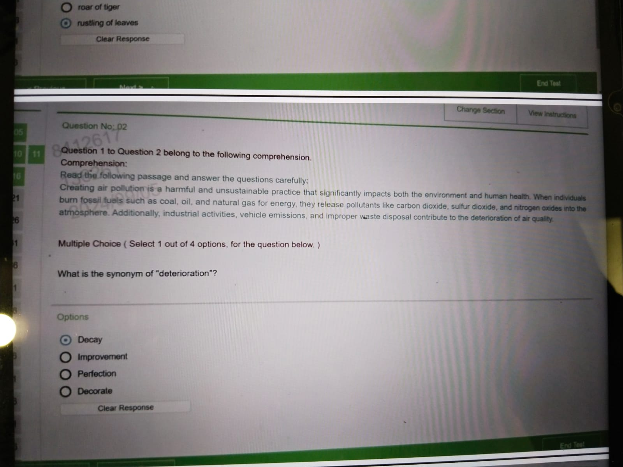


Slide 53
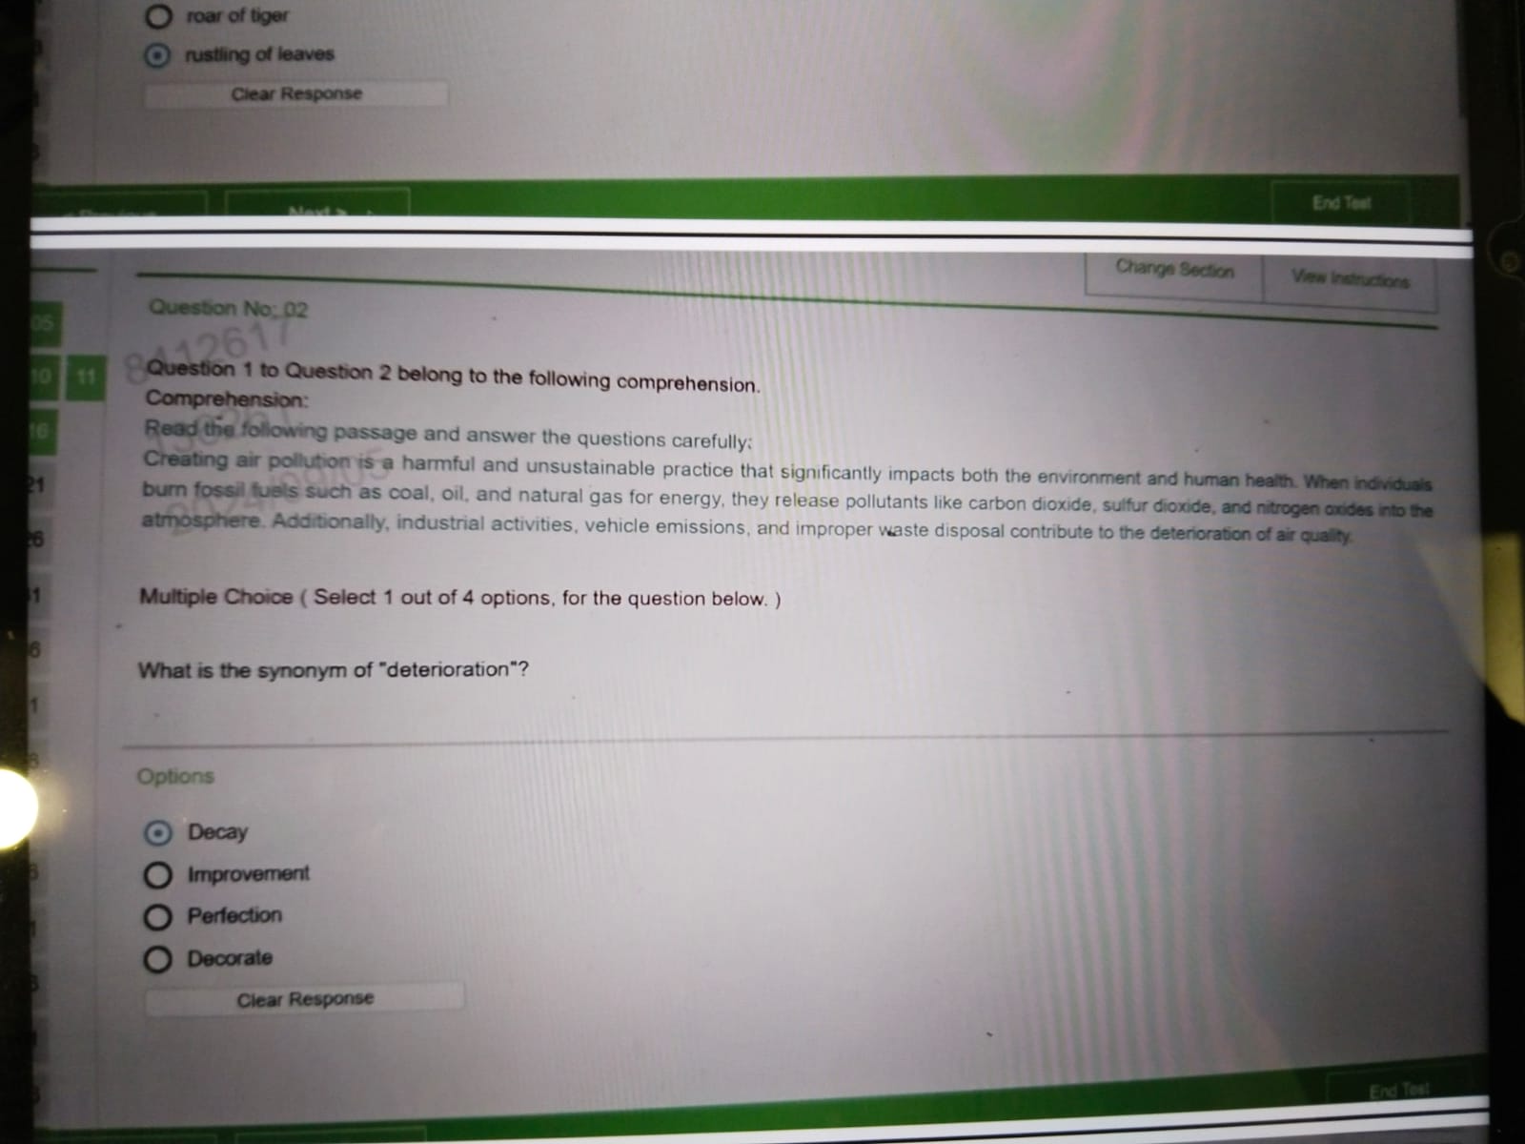


Slide 54



Slide 55



Slide 56



Slide 57



Slide 58



Slide 59



Slide 60



Slide 61
Critical Reasoning
Accenture Hirepro

Slide 62


Slide 63


Slide 64


Slide 65


Slide 66


Slide 67


Slide 68


Slide 69


Slide 70


Slide 71


Slide 72


Slide 73


Slide 74


Slide 75


Slide 76


Slide 77


Slide 78


Slide 79


Slide 80


Slide 81


Slide 82


Slide 83


Slide 84


Slide 85


Slide 86


Slide 87


Slide 88


Slide 89


Slide 90


Slide 91


Slide 92


Slide 93


Slide 94


Slide 95


Slide 96


Slide 97


Slide 98


Slide 99


Slide 100


Slide 101


Slide 102


Slide 103


Slide 104


Slide 105


Slide 106


Slide 107


Slide 108


Slide 109


Slide 110


Slide 111


Slide 112


Slide 113


Slide 114


Slide 115


Slide 116


Slide 117


Slide 118


Slide 119


Slide 120


Slide 121


Slide 122


Slide 123


Slide 124


Slide 125


Slide 126


Slide 127


Slide 128


Slide 129


Slide 130


Slide 131


Slide 132


Slide 133


Slide 134


Slide 135
Abstract Reasoning
Accenture Hirepro

Slide 136


Slide 137


Slide 173
Pseudocode Section
Accenture Hirepro

Slide 200


Slide 221


Slide 227
Common Application and Ms office
Accenture Hirepro

Slide 228
Answer : Network Server
Notes:
Network Server

Slide 229

Answer : Primary and Secondary

Slide 230
Answer : Formula Bar

Slide 231


Slide 232
Answer : ALU

Slide 233
Answer : =

Slide 234
Answer : MAX

Slide 235
Answer : Automatically moves text to the next line when necessary

Slide 236
Answer : Pen Drive

Slide 237
Answer : Both A and C

Slide 238
Answer : Change Case

Slide 239
Answer : Workbook

Slide 240
Answer : Restarting Computer

Slide 241
Answer : F5

Slide 242
Answer : Count

Slide 243
Answer : MS Access

Slide 244
Answer : All of the above

Slide 245
Answer : Using the “Insert” menu

Slide 246
Answer : Internet Explorer

Slide 247
Answer : Excel

Slide 248
Answer : Ctrl + O

Slide 249
Answer : NETWORKDAYS

Slide 250
Answer : Count

Slide 251
Answer : Filtering

Slide 252
Answer : ASCII

Slide 253
Answer : Outlook

Slide 254
Answer : Secondary

Slide 255
Answer : Word

Slide 256
Answer : LAN

Slide 257
Networking and Cloud
Accenture Hirepro

Slide 258


Slide 301
Important some old
Repeated Questions

Slide 337


Slide 346
Accenture Coding Questions
Hirepro

Slide 347


Slide 348
Logic
Convert the integer to binary: You can use built-in functions to convert an integer to its binary representation.
Count the number of ones: Once you have the binary string, count the number of '1' characters.

Slide 349
import java.util.Scanner;
public class CountOnesInBinary {
public static void main(String[] args) {
Scanner scanner = new Scanner(System.in);
System.out.print("Enter an integer: ");
int number = scanner.nextInt();
int count = Integer.bitCount(number);
System.out.println("Number of ones in the binary representation of " + number + " is: " + count);
}
}
def count_ones_in_binary(number):
return bin(number).count('1')
number = int(input("Enter an integer: "))
count = count_ones_in_binary(number)
print(f"Number of ones in the binary representation of {number} is: {count}")

Slide 351
Edge Cases: If the array has fewer than two distinct elements, both implementations handle this scenario by checking if the second smallest element has been updated from its initial value.

Slide 353


Slide 356
Second Smallest Element in the array

Slide 357
https://www.geeksforgeeks.org/frequent-word-array-strings/

Slide 360
Min and Max element in the array

Slide 361
Min element in the array

Slide 362
Input: [TeamA,TeamB,TeamB,TeamC,TeamA,TeamD,TeamA
Output : TeamA

Slide 363
Thank you

